Slide 1

Subject Name: DevOps
Unit:2 Unit Name:Version Control System
Faculty Name : Ms. Puja Padiya

Slide 2
Index
Lecture – Version Control | 3

Slide 3
Unit No 2: Version Control System
Lecture:
Version Control

Slide 4


Slide 5


Slide 6
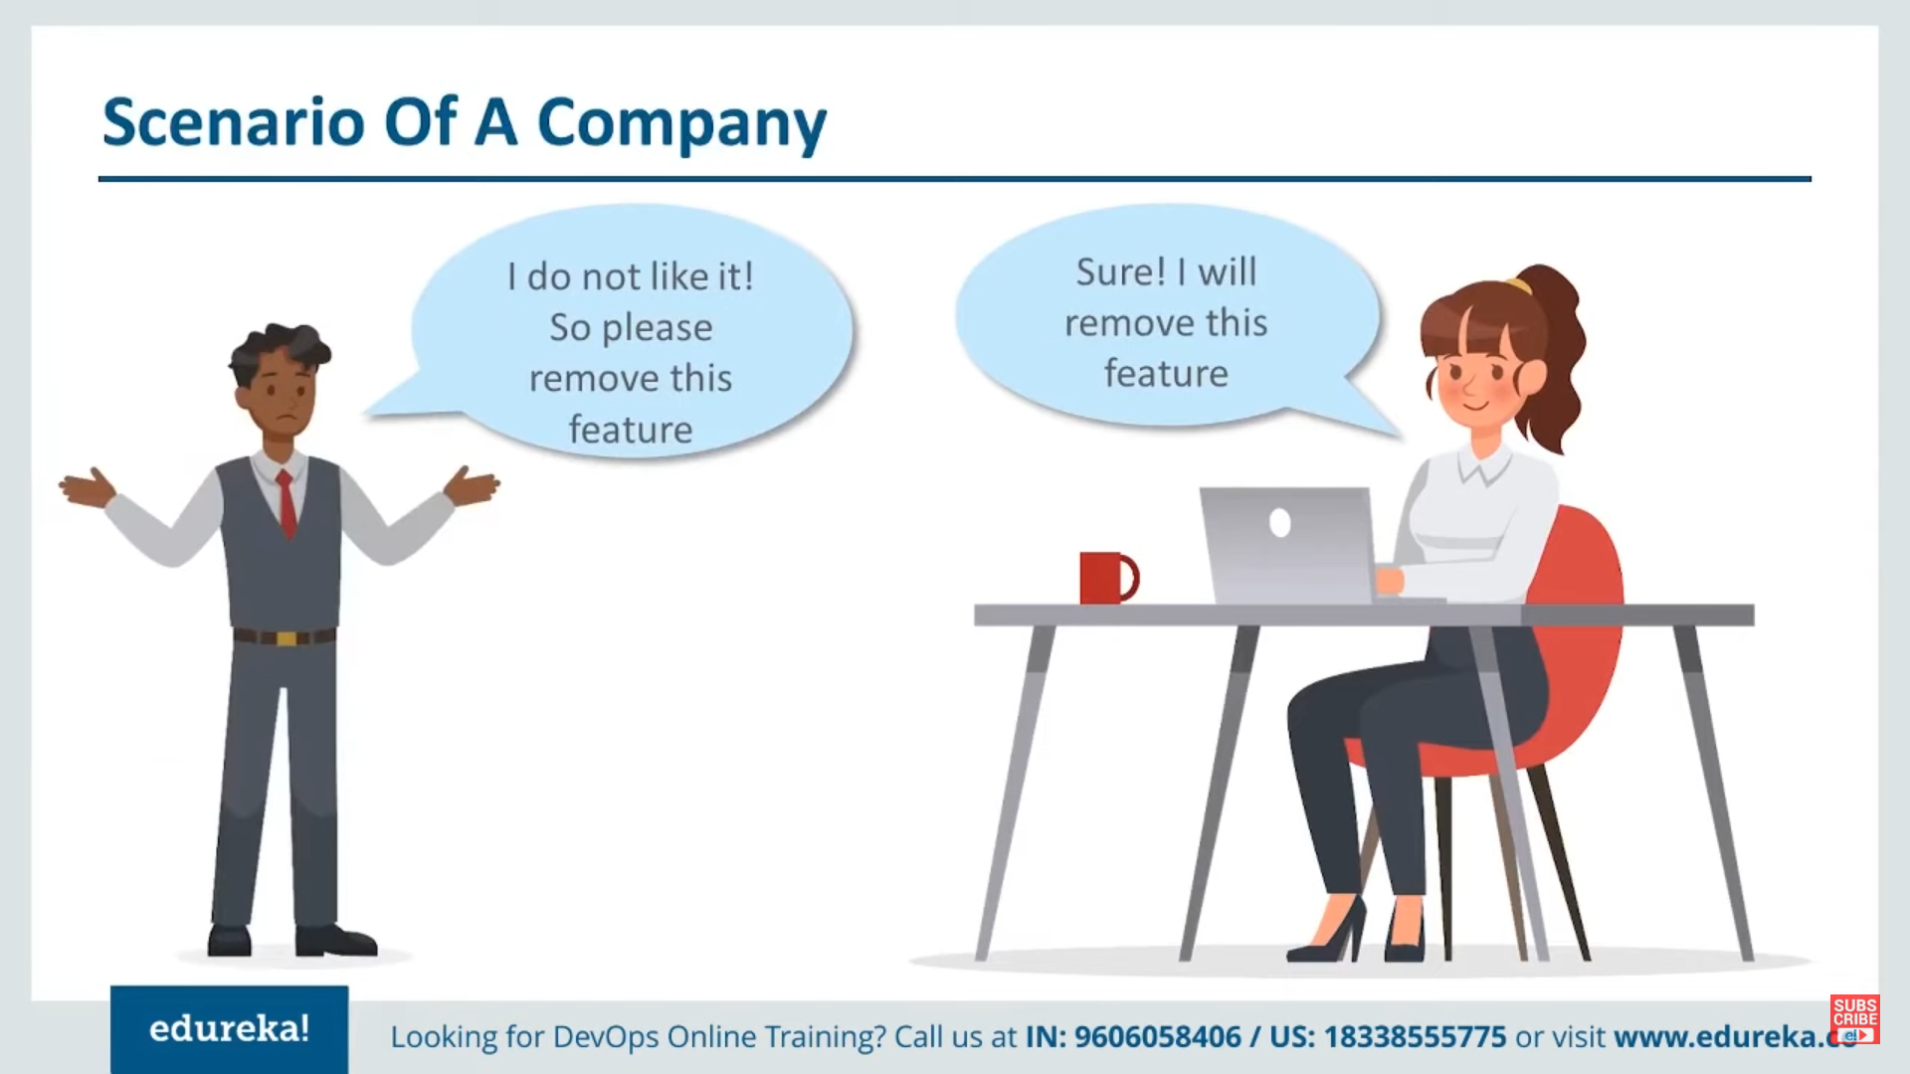

Slide 7
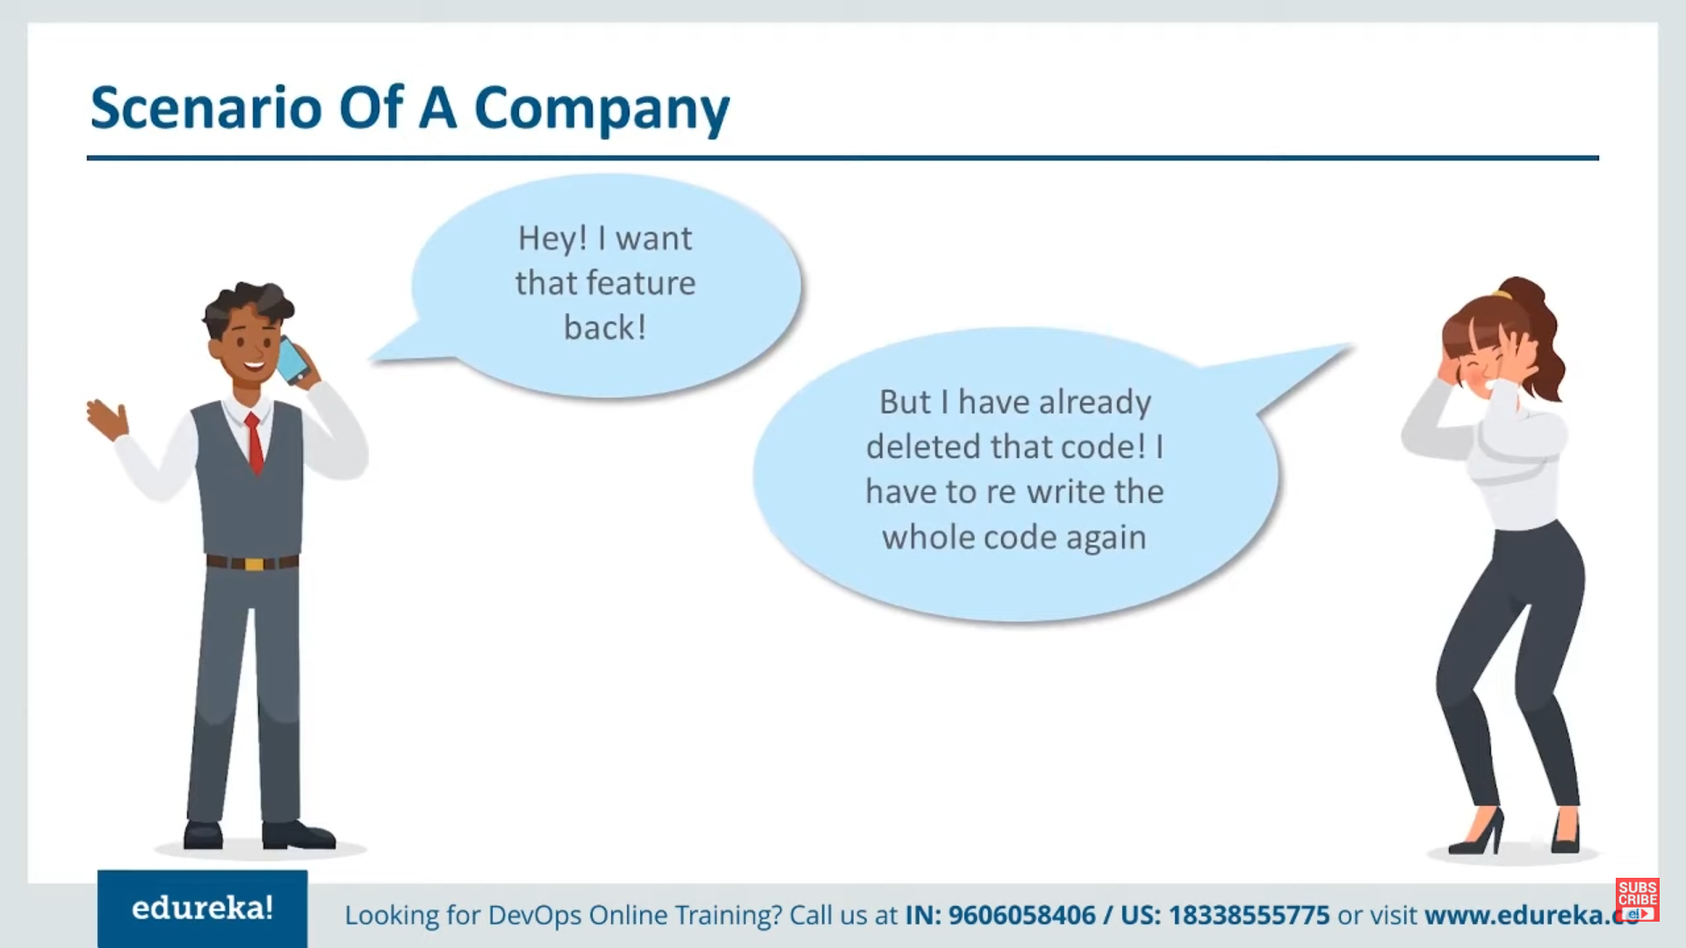

Slide 8
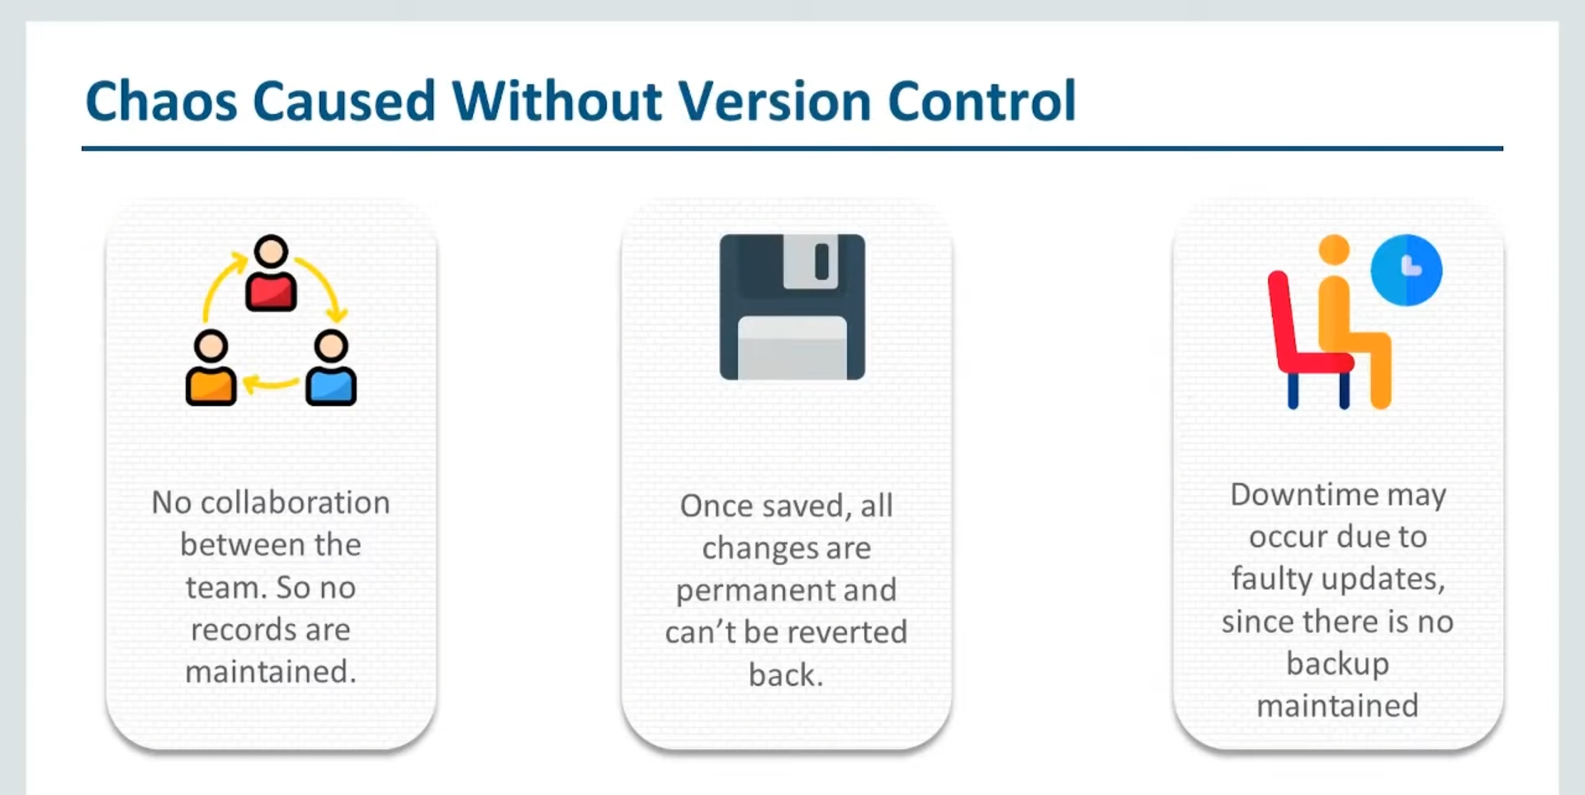

Slide 9
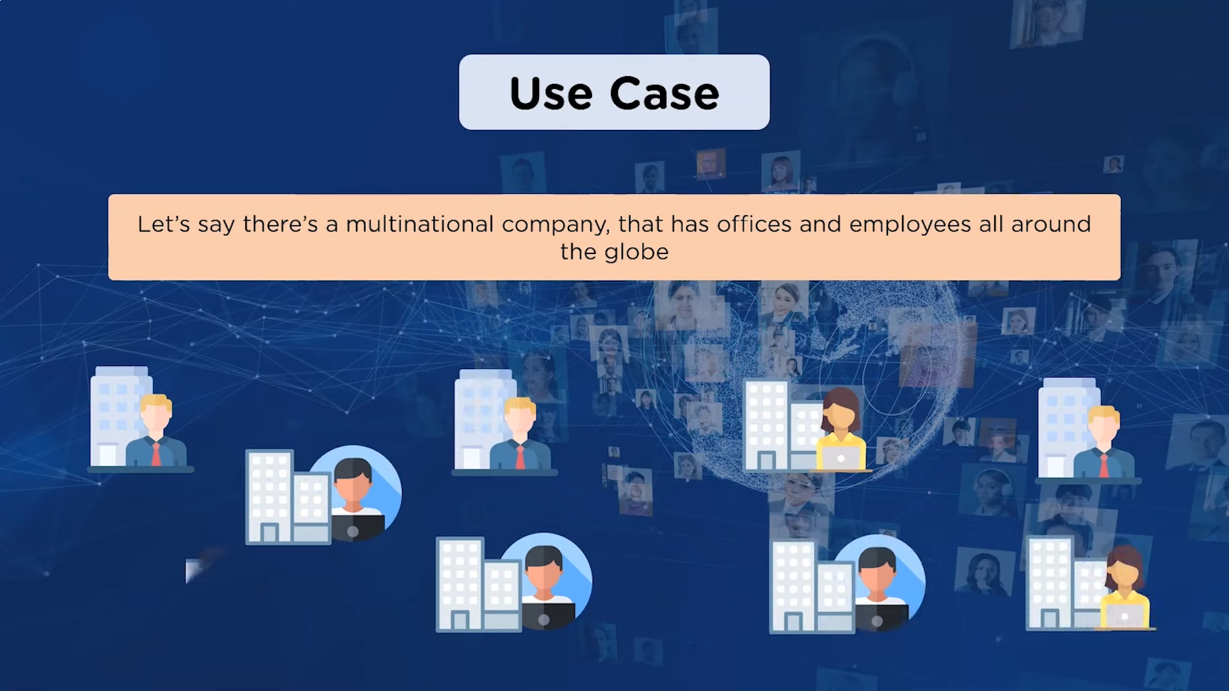

Slide 10
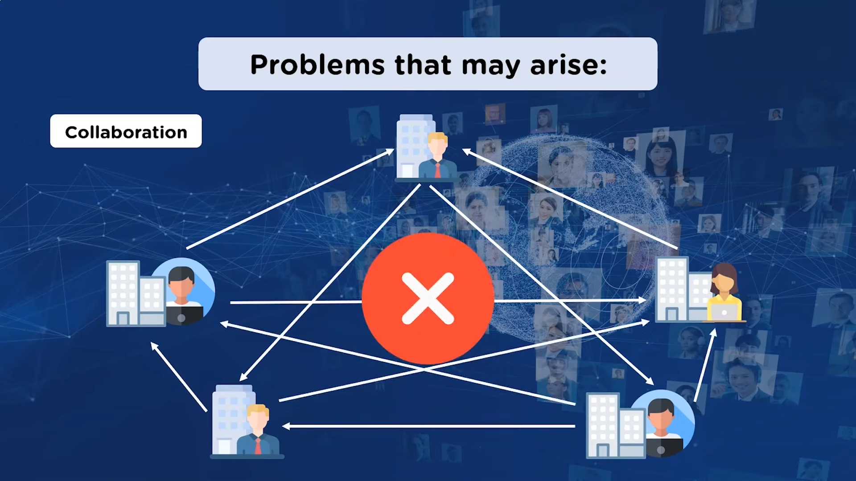

Slide 11
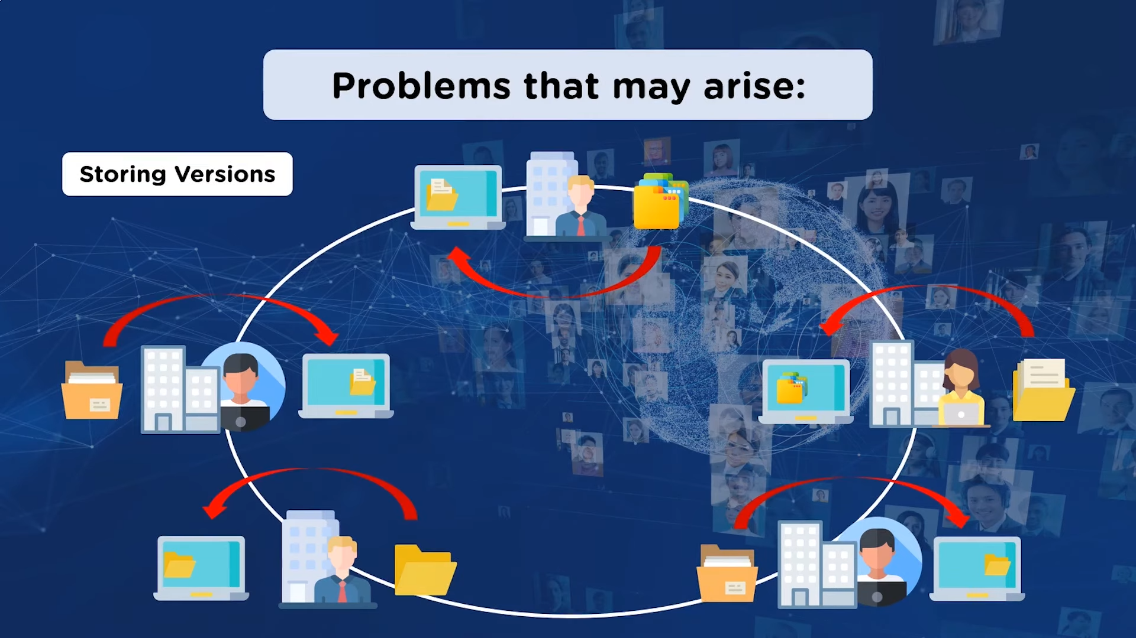

Slide 12
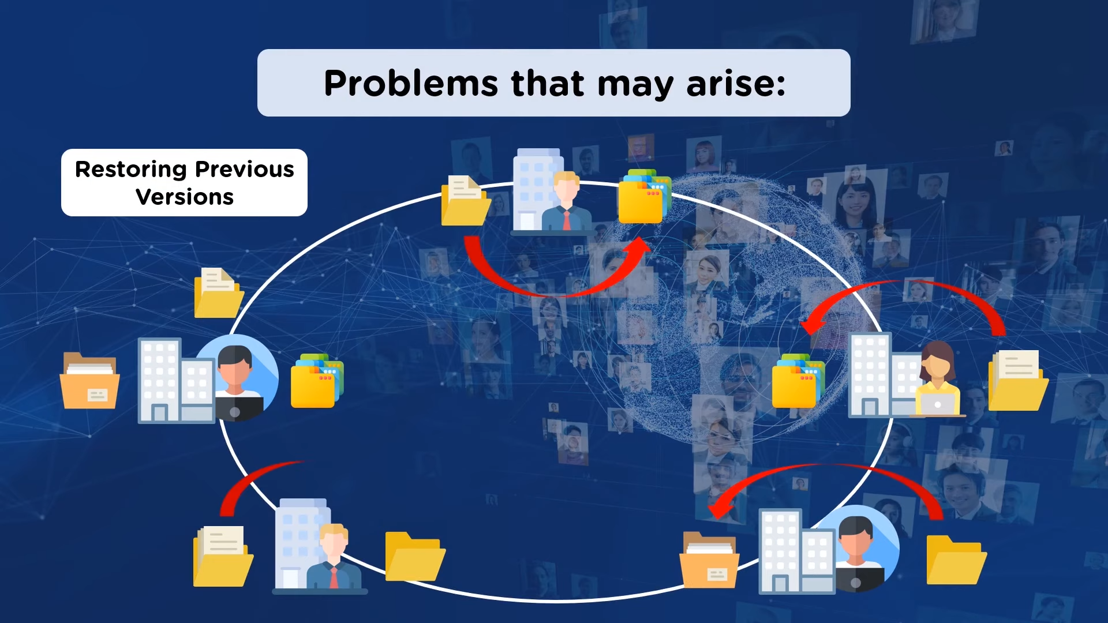

Slide 13
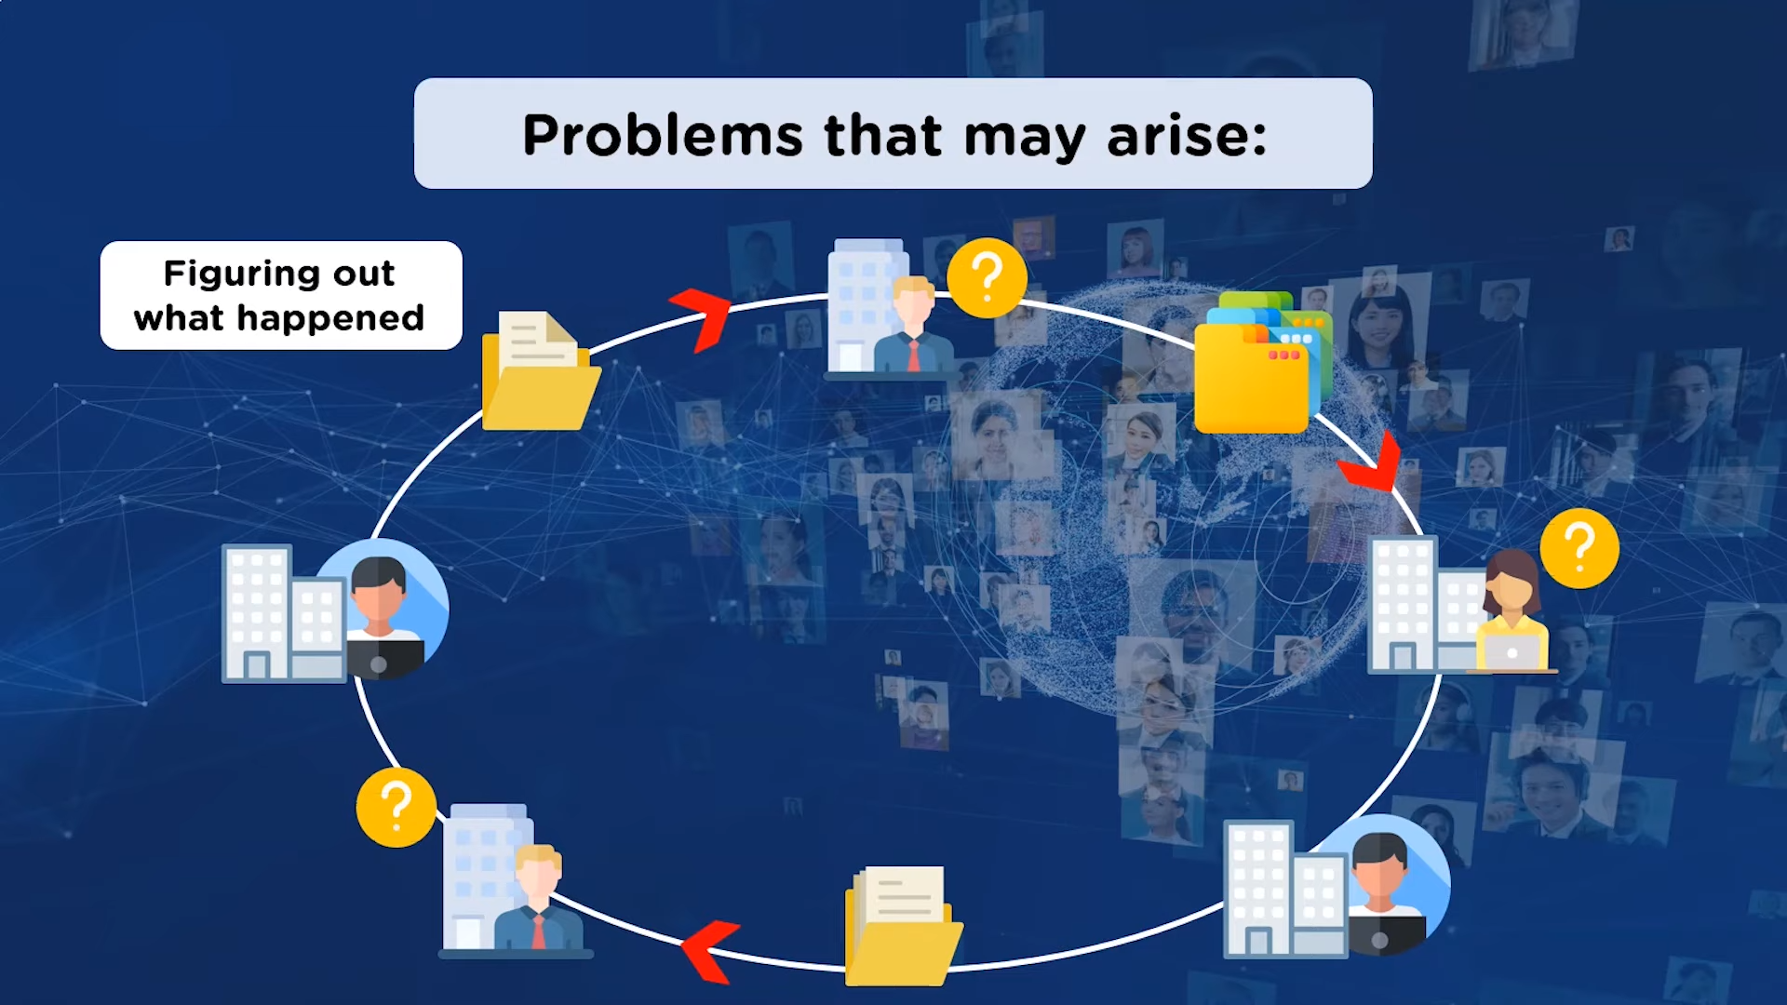

Slide 14
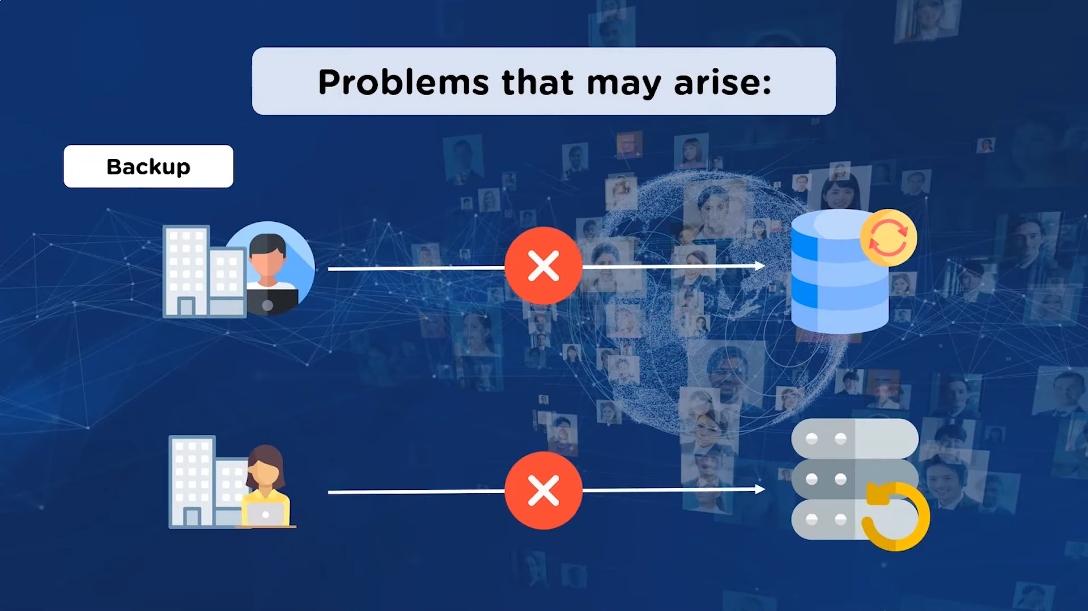

Slide 15


Slide 16
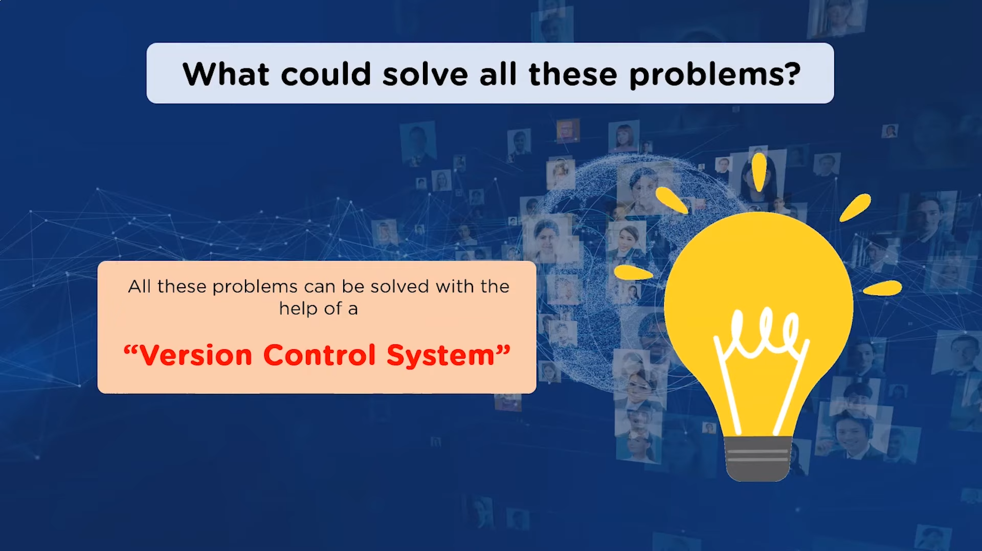

Slide 17
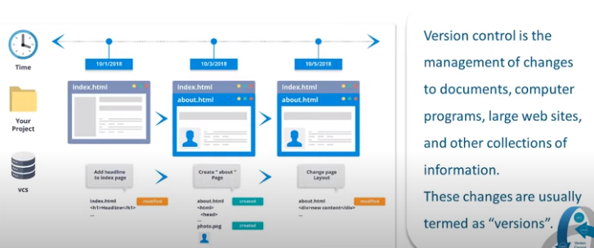
Version Control

Slide 18

Why Version Control?
Collaboration Versioning Rolling Back Understanding
Scenario : Multiple students are doing a project together
Question: Why not Google drive & One drive ????
source code management vs file storage management

Slide 19
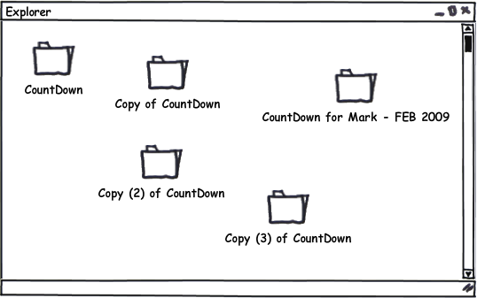
Why do we need Version Control?
Maintaining group Projects
Patches are mostly sent via email
Difficult to roll back
Almost impossible to maintain if the number of people working in the project is large
Testing new unstable features

Slide 20


Slide 21
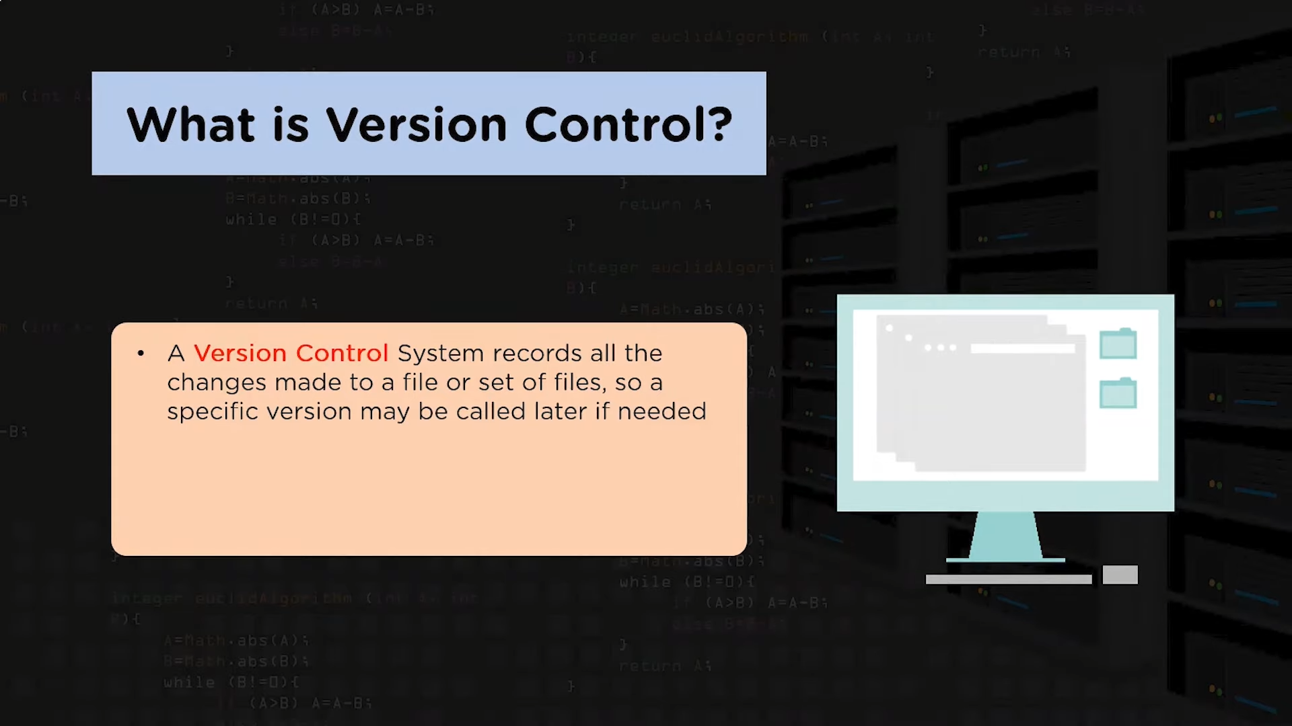

Slide 22
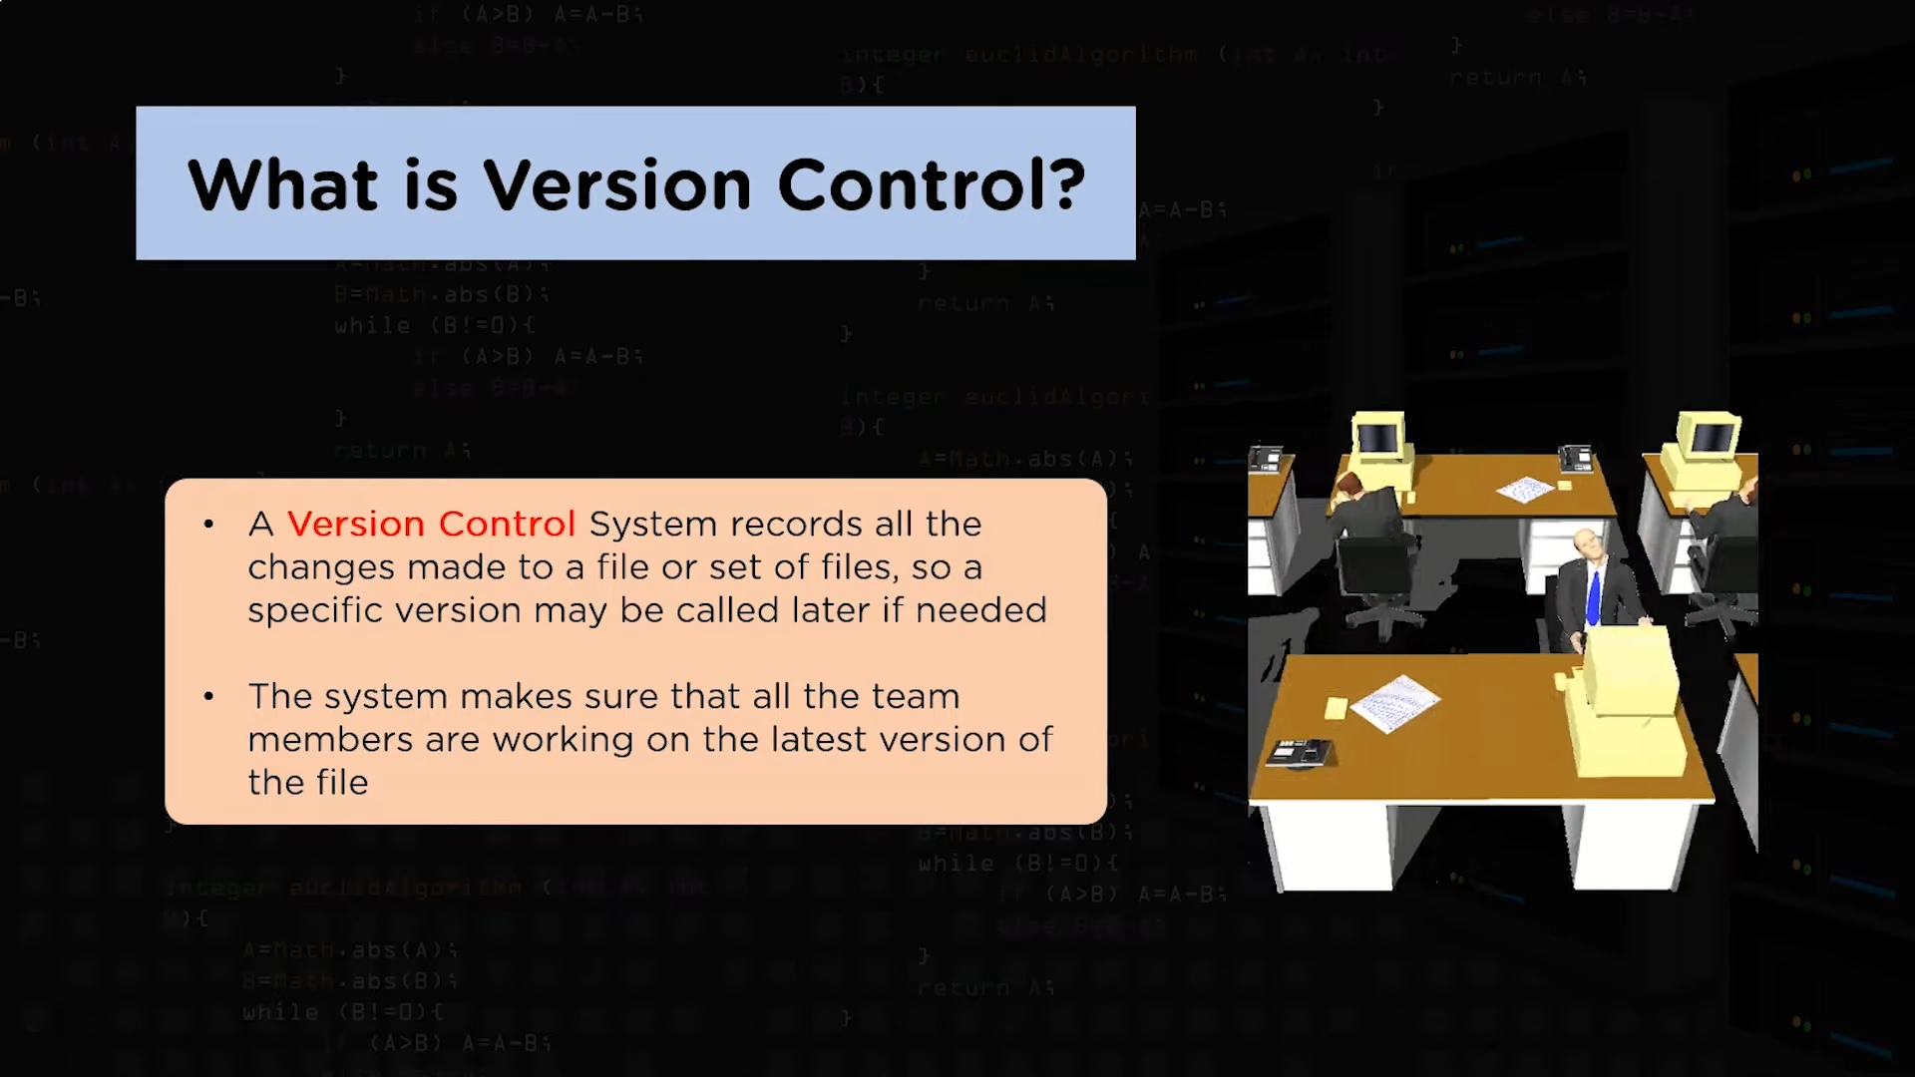

Slide 23
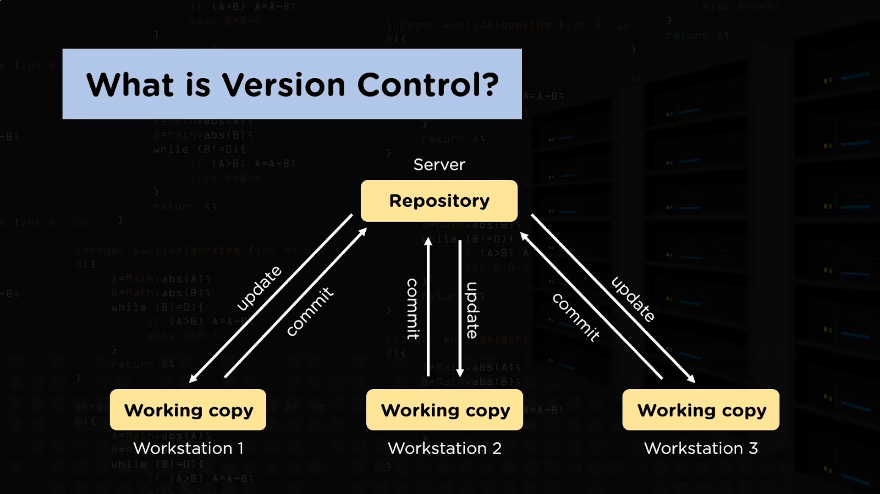

Slide 24
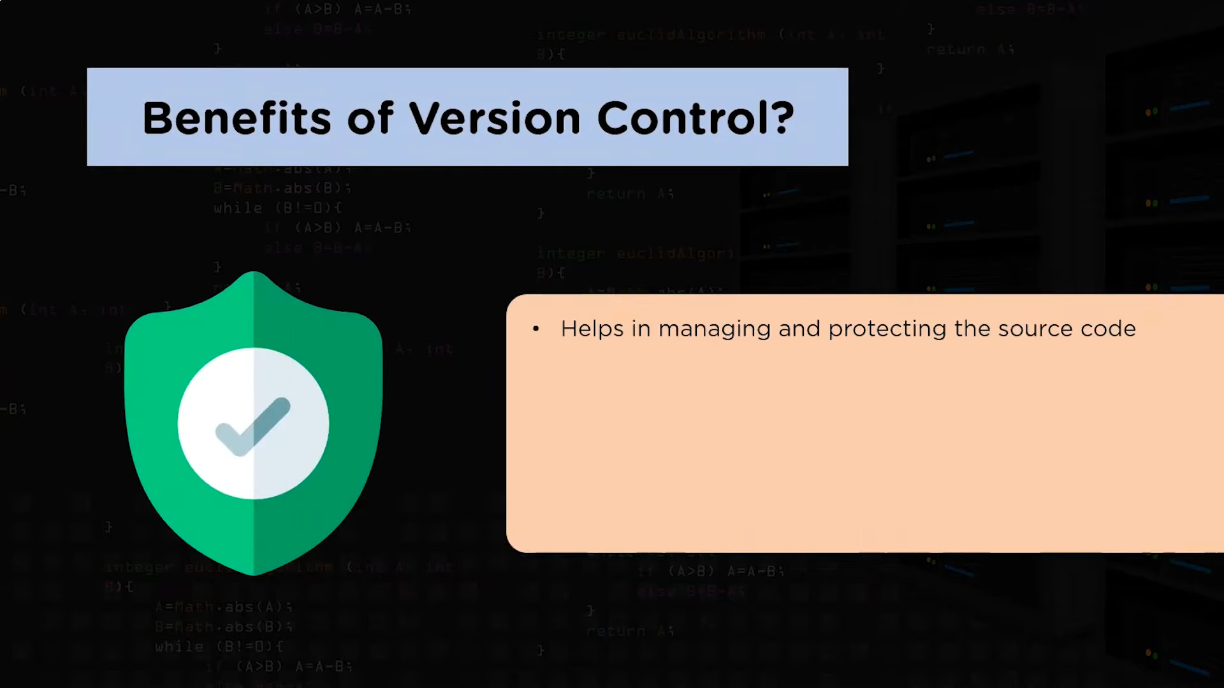

Slide 25
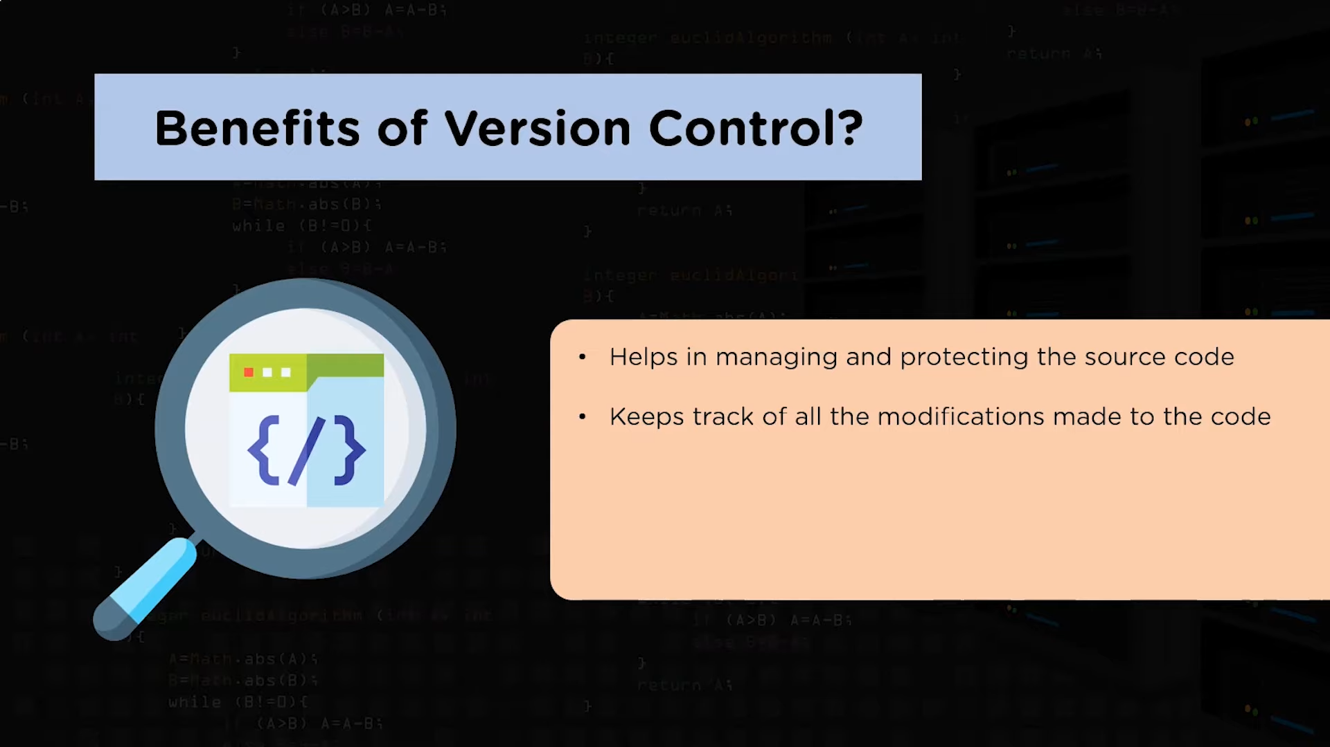

Slide 26
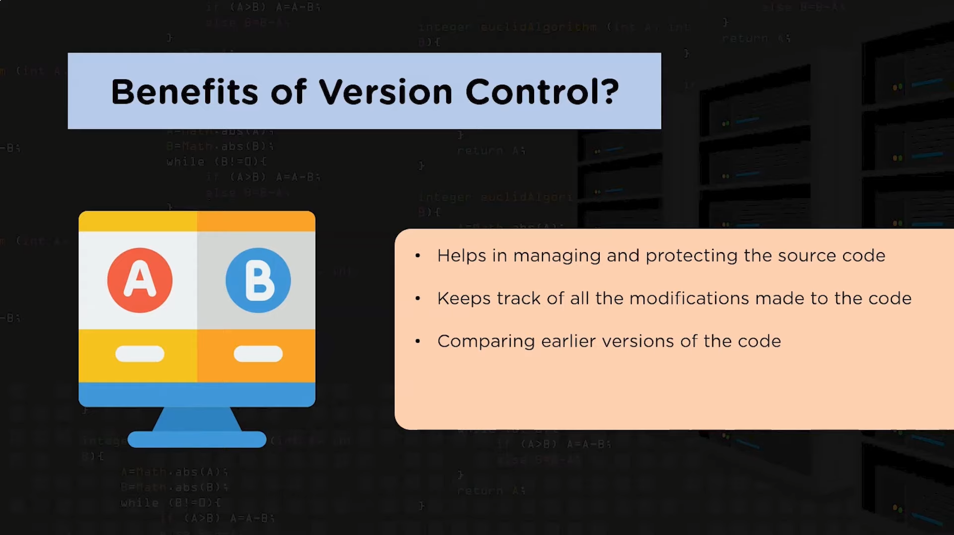

Slide 27
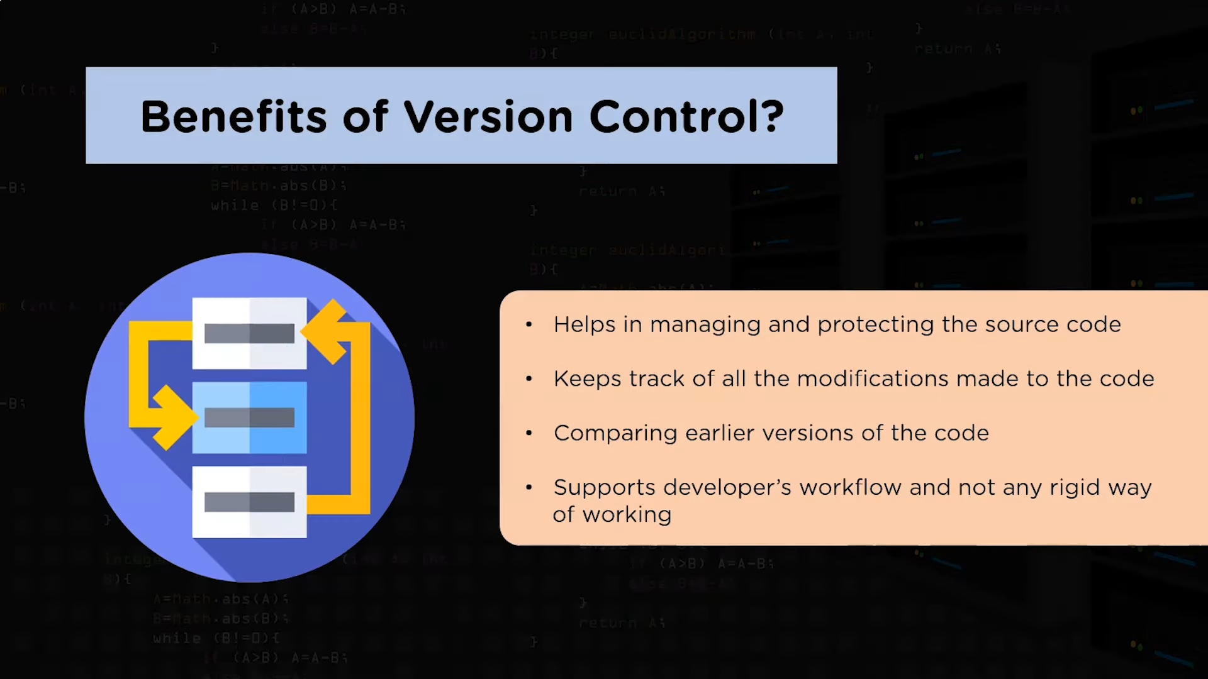

Slide 28
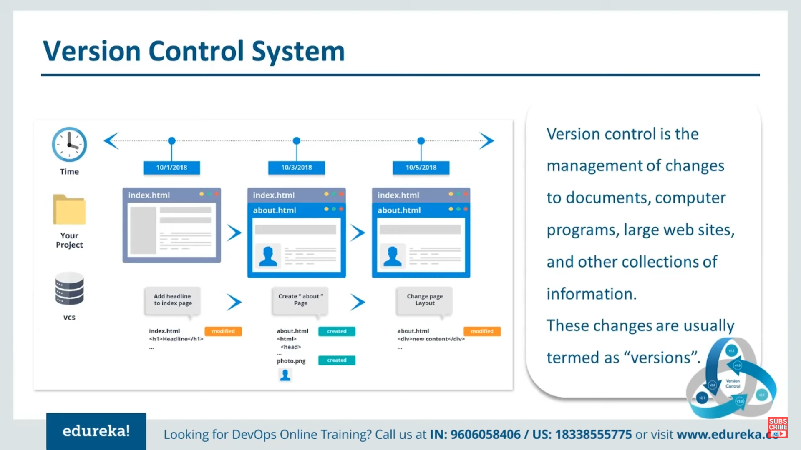

Slide 29
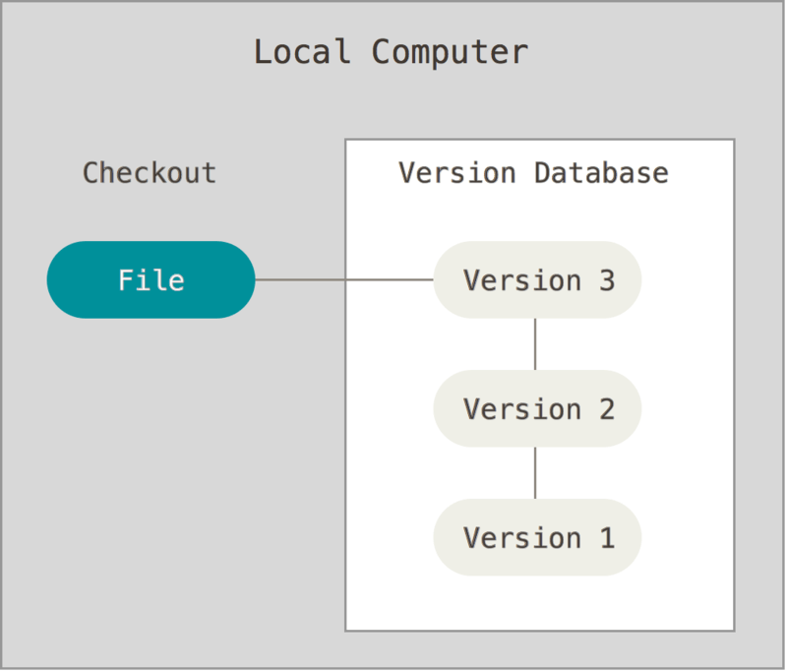
Version Control: What is it?
A method for recalling versions of a codebase
Keeping a record of changes
Who did what and when in the system
Save yourself when things inevitably go wrong

Slide 30
Version Control: Individual
Individual
Back-ups of the project
Create a “checkpoint” in the project at any stage: Fearlessly modify code
Tagging: Mark certain point in time
Branching: Release versions and continue development

Slide 31
Version Control: Team
Team
Everything in “Individual”
Allow multiple developer to work on the same codebase
Merge changes across same files: handle conflicts
Check who made which change: blame/praise

Slide 32
Version Control: Types
Centralised VCS
Distributed VCS
A single authoritative data source (repository)
Check-outs and check-ins are done with reference to this central repository
No single repository is authoritative
Data can be checked in and out from any repository

Slide 33
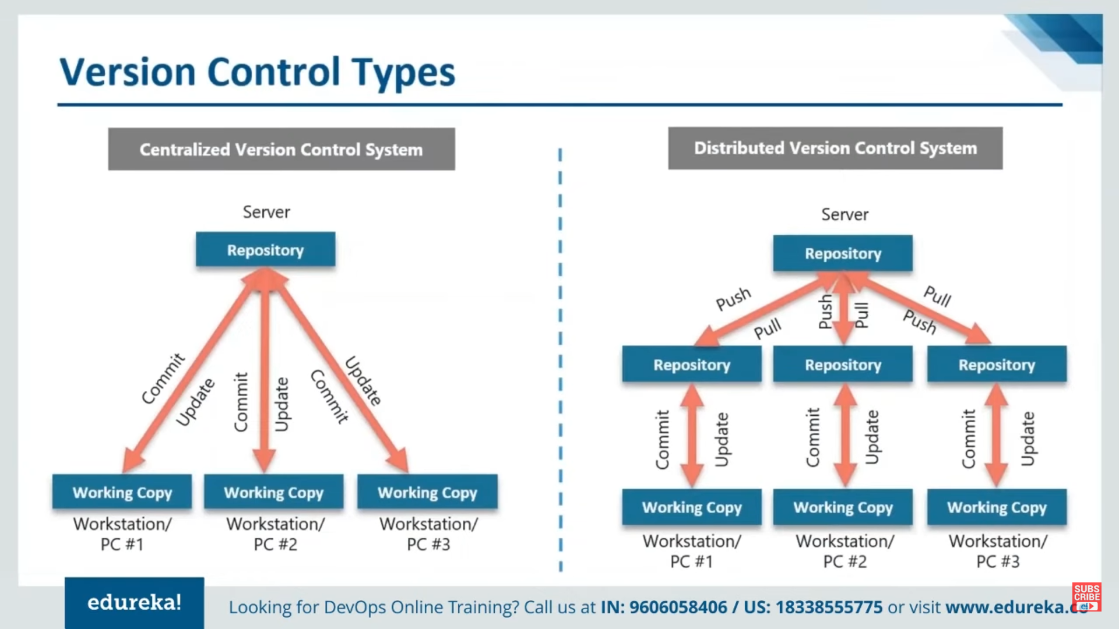
No single repository is authoritative
Single repository is authoritative
Examples: Subversion (SVN)
Concurrent Version System (CVS),
Examples: Git, Mercurial

Slide 34
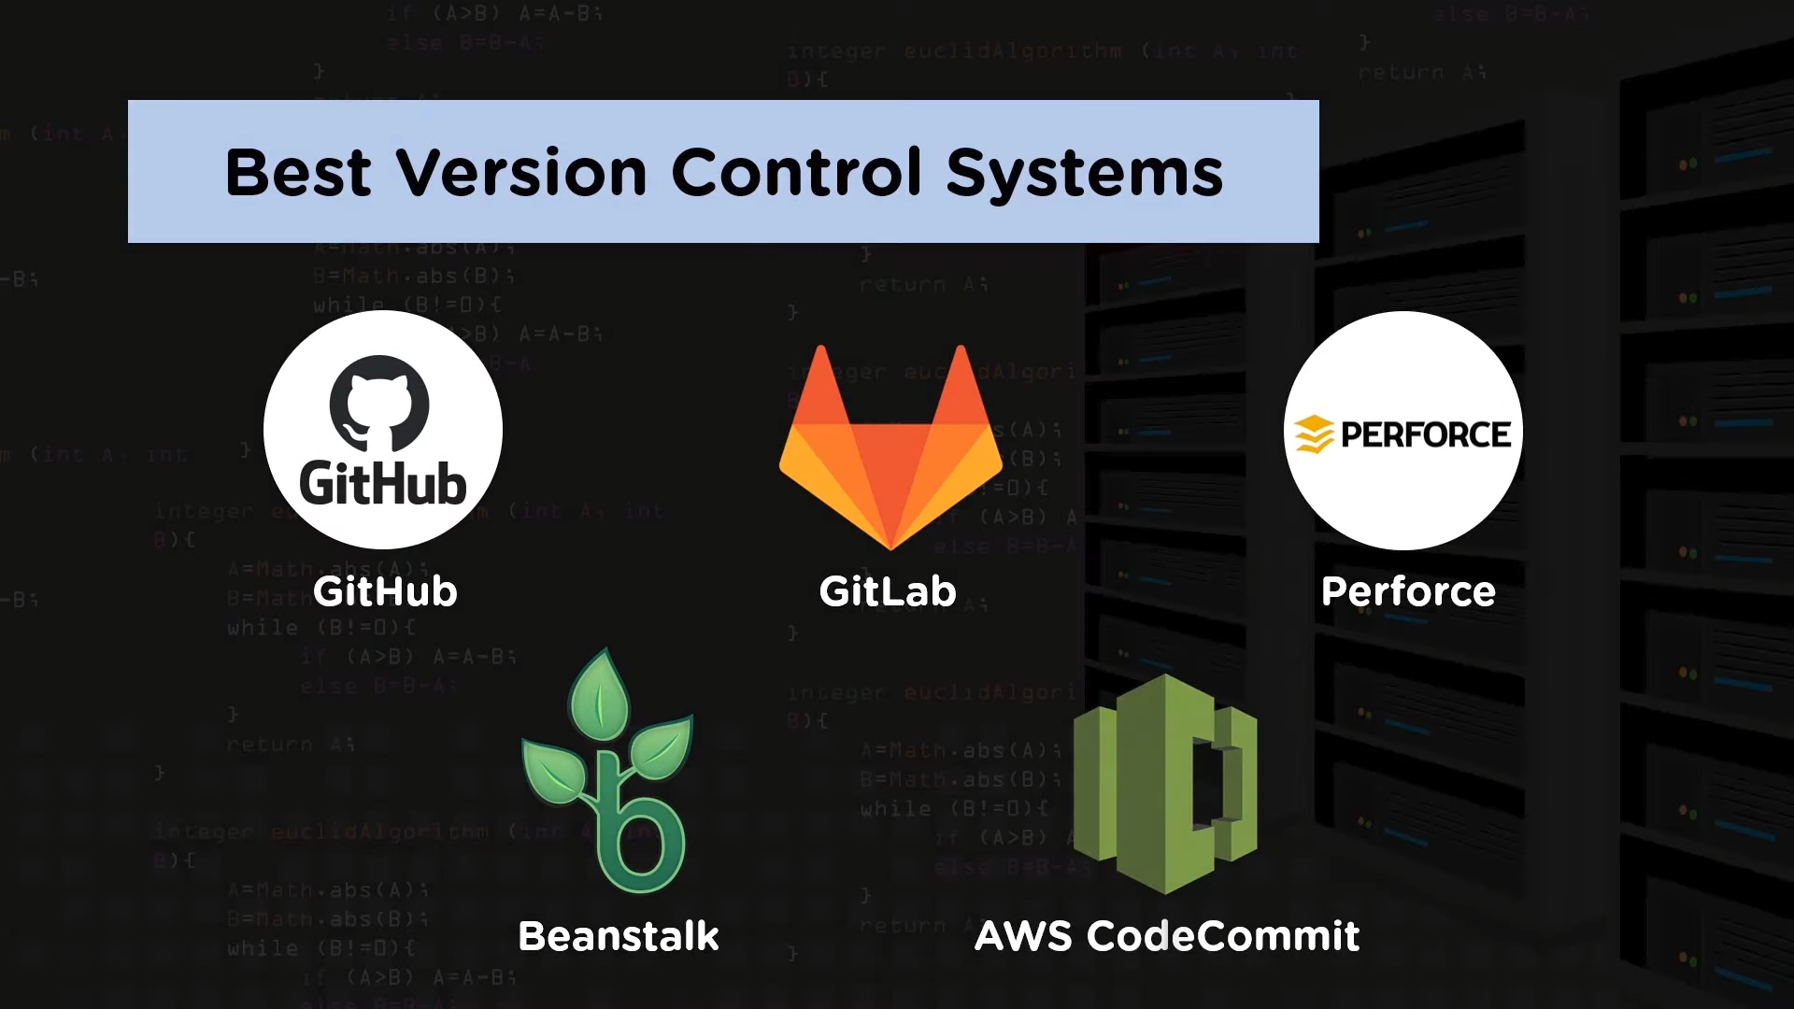

Slide 35
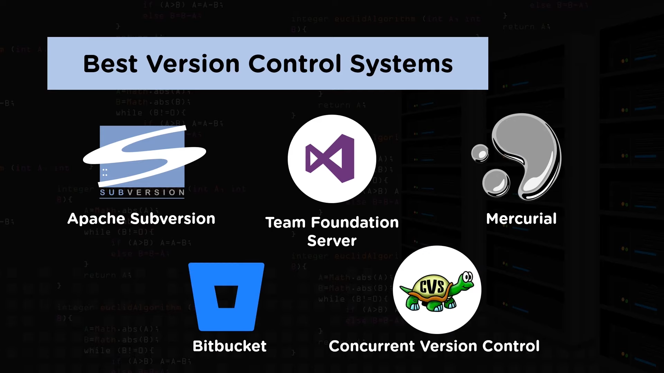

Slide 36
Version Control: Take Away Points
For working by yourself:
Gives you a “time machine” for going back to earlier versions
Gives you great support for different versions (standalone, web app, etc.) of the same basic project
For working with others:
Greatly simplifies concurrent work, merging changes
For getting an internship or job:
Any company with a clue uses some kind of version control
Companies without a clue are bad places to work

Slide 37

Thank You

Slide 38
Unit No 2: Version Control System
Lecture: GIT

Slide 39
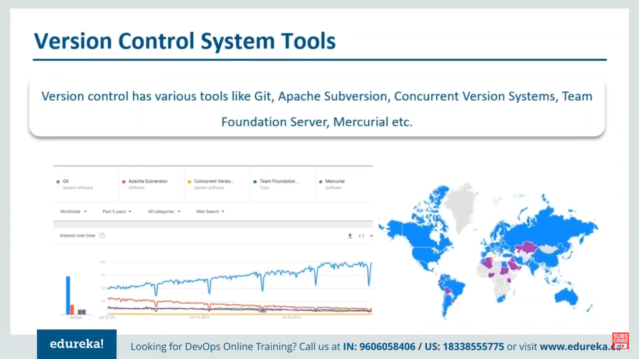

Slide 40
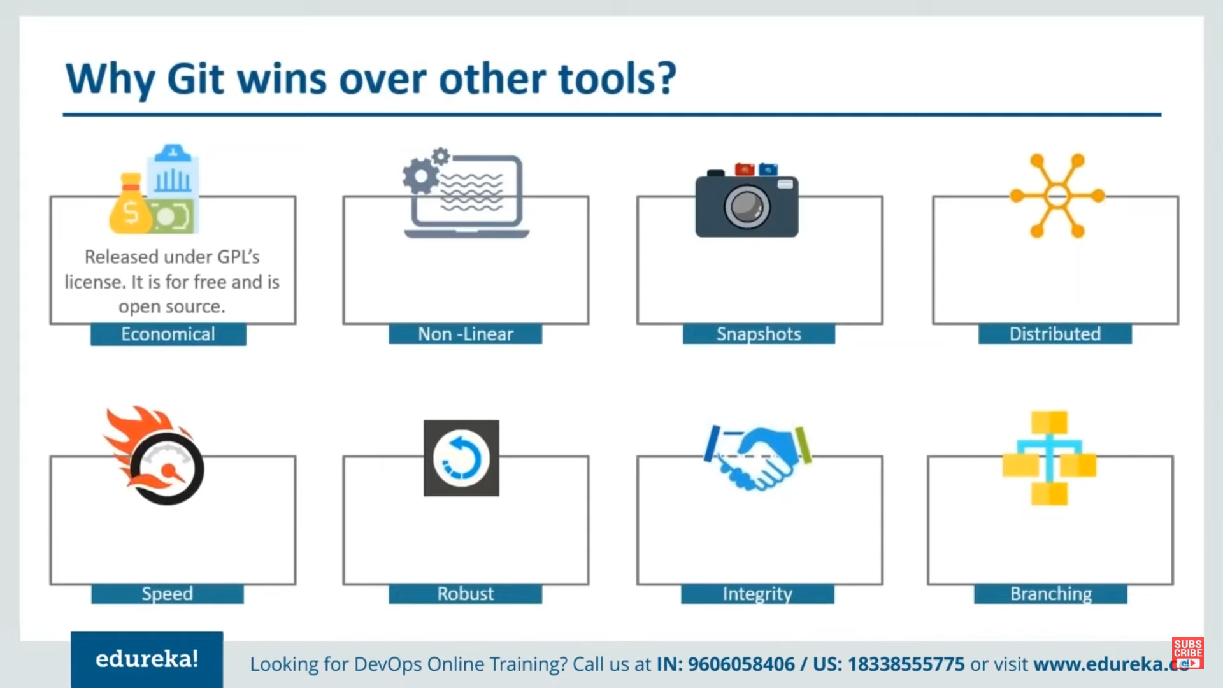

Slide 41
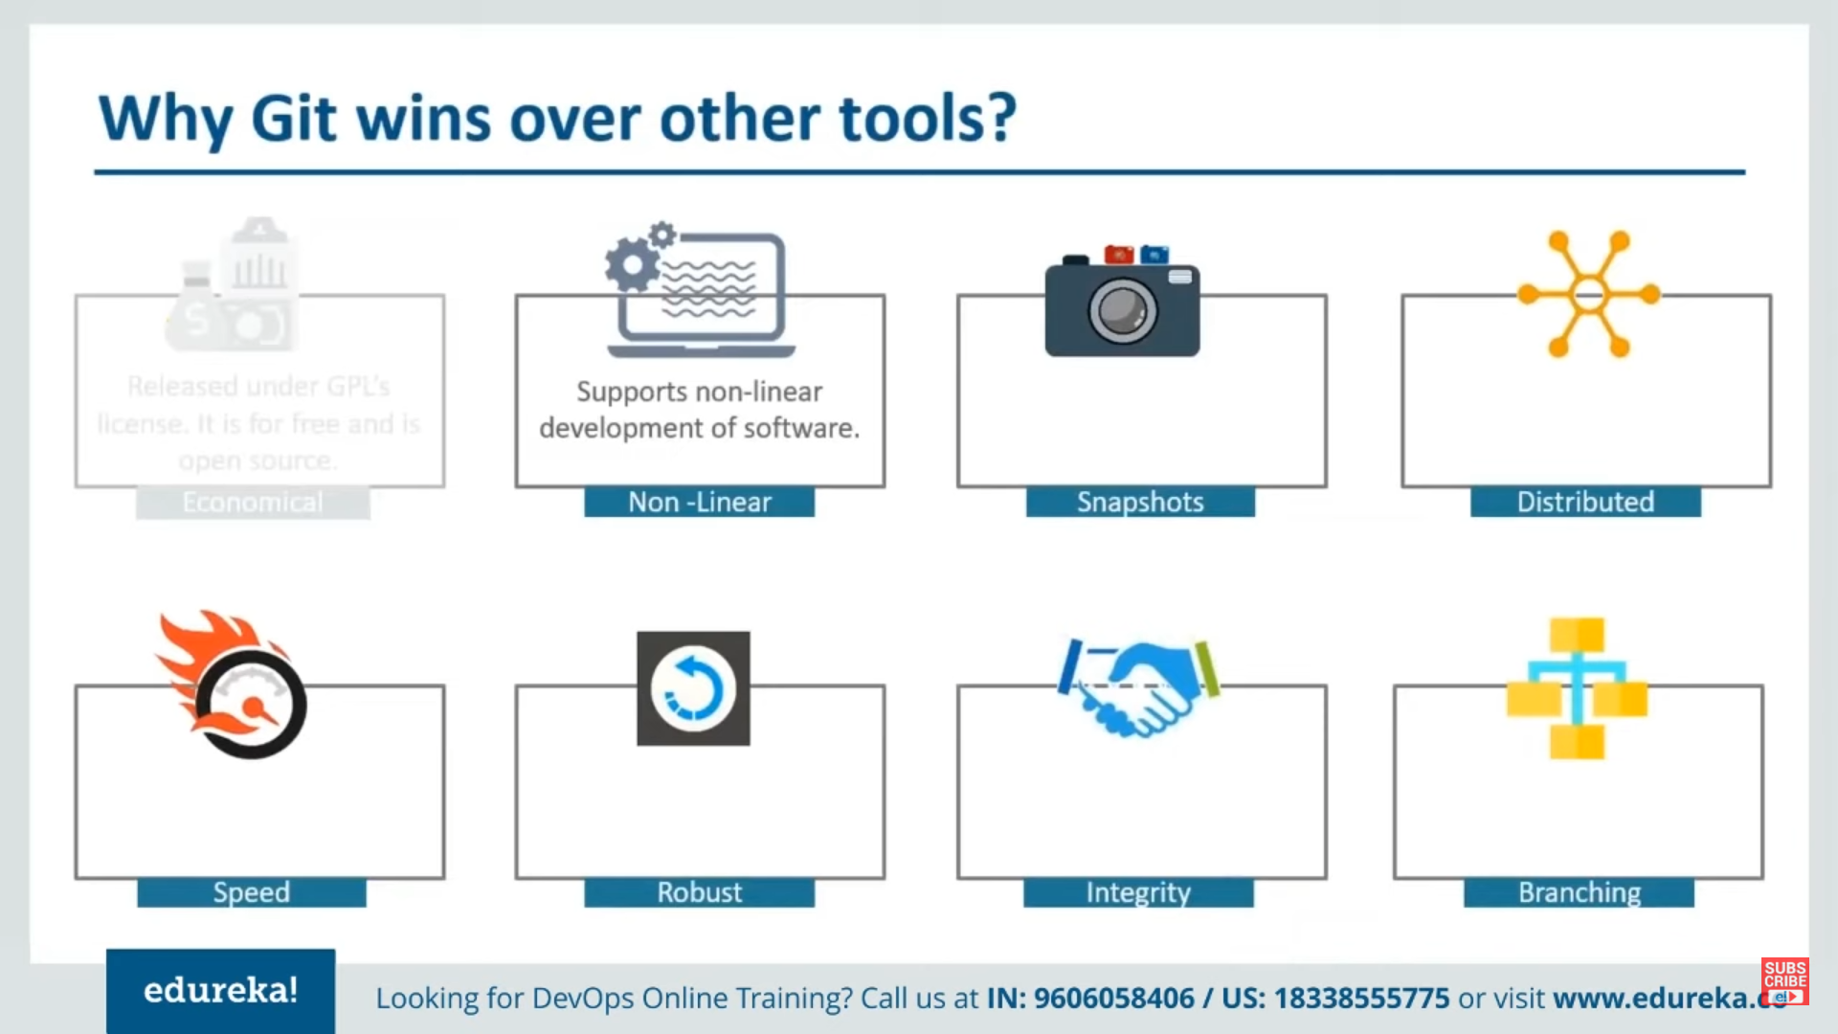

Slide 42
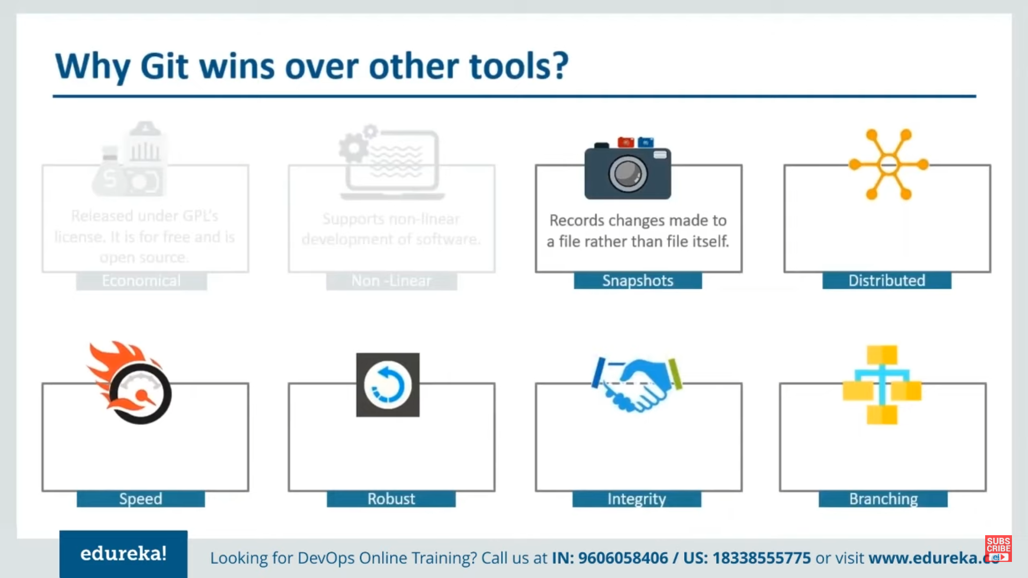

Slide 43
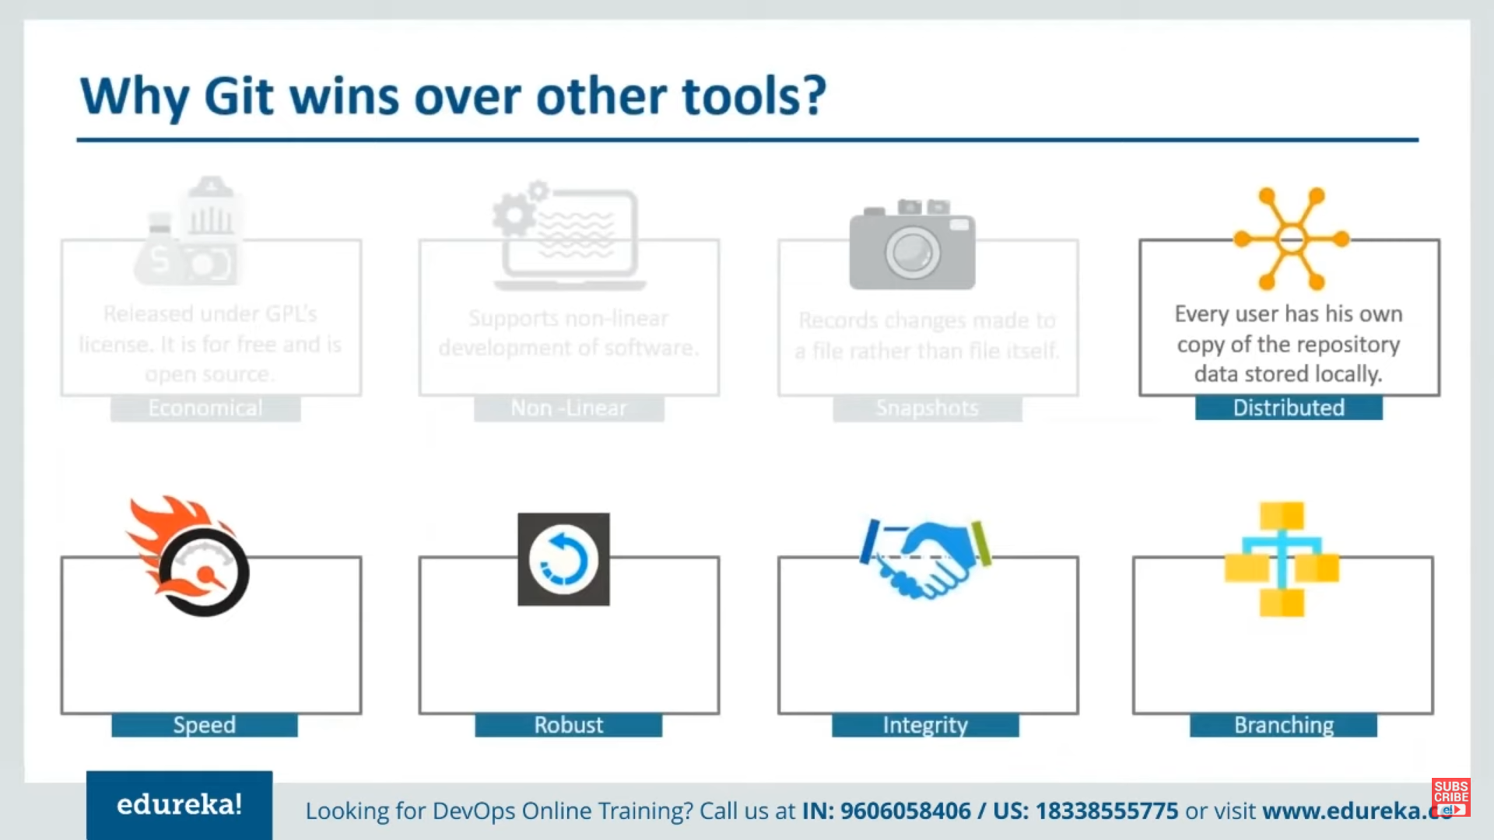

Slide 44
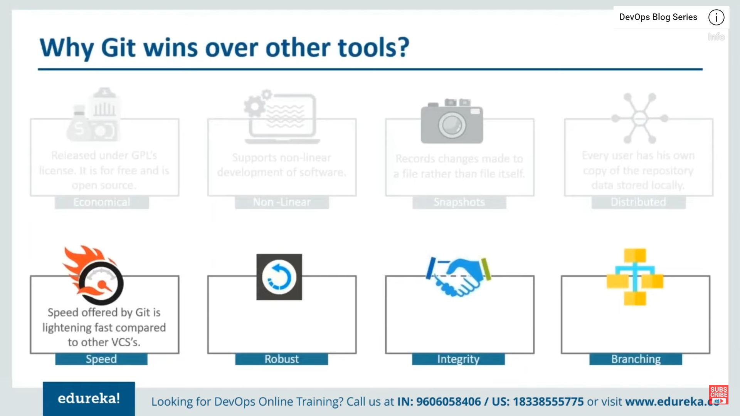

Slide 45
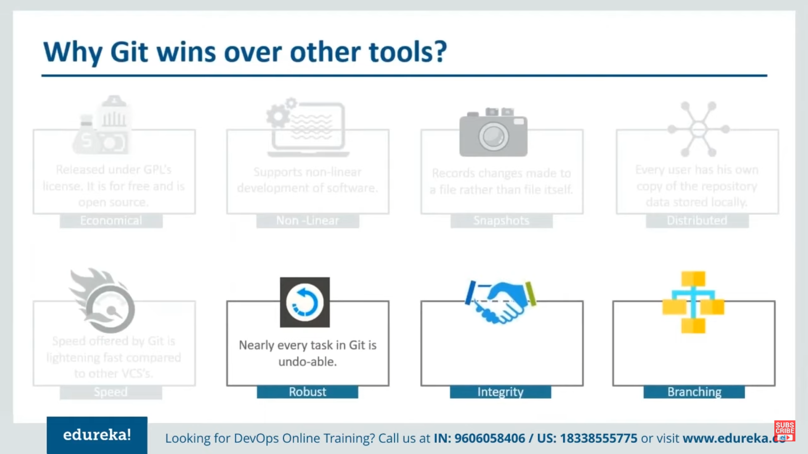

Slide 46
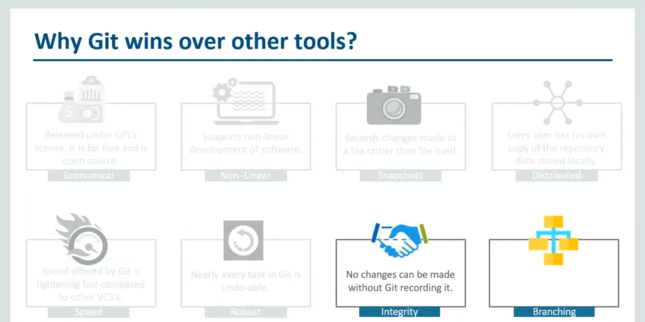

Slide 47
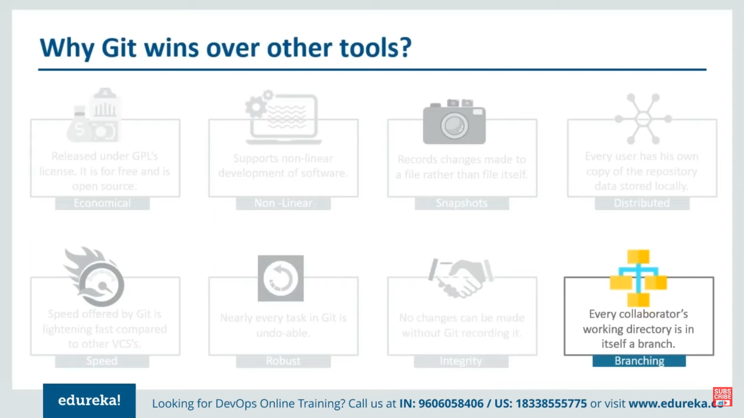

Slide 48
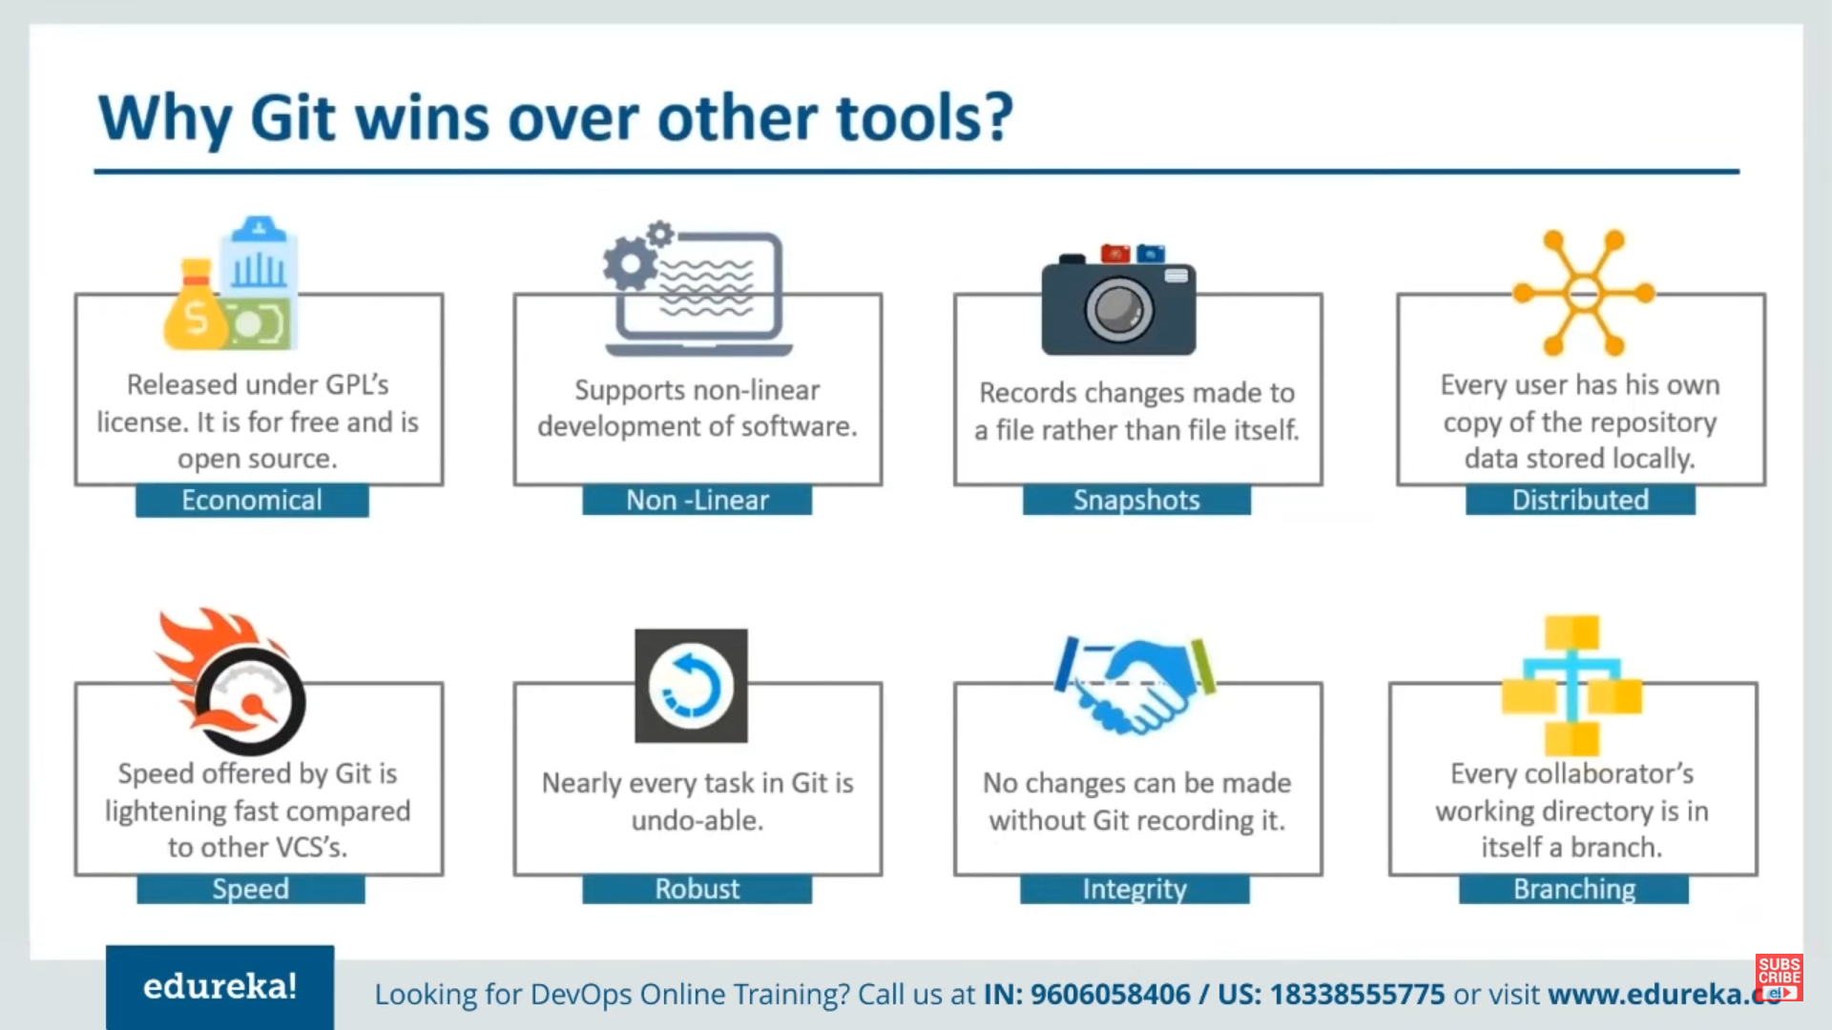

Slide 49

Git History
Came out of Linux development community
Linus Torvalds, 2005
Initial goals:
Speed
Support for non-linear development (thousands of parallel branches)
Fully distributed
Able to handle large projects like Linux efficiently
Global Information Tracker (acronym name)

Slide 50

What is Github?
GitHub was developed by Chris Wanstrath, P. J. Hyett, Tom Preston-Werner and Scott Chacon using Ruby on Rails, and started in February 2008
It is a subsidiary of Microsoft, which acquired the company in 2018 for $7.5 billion
GitHub.com is a site for online storage of Git repositories.
You can get free space for open source projects or you can pay for private projects.
Question: Do I have to use Github in order to use Git?
Answer: No!
you can use Git completely locally for your own purposes, or
you or someone else could set up a server to share files, or
you could share a repo with users on the same file system.

Slide 51
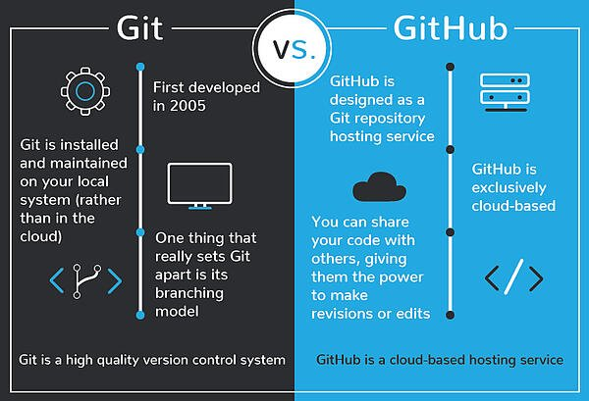
Git vs GitHub

Slide 52
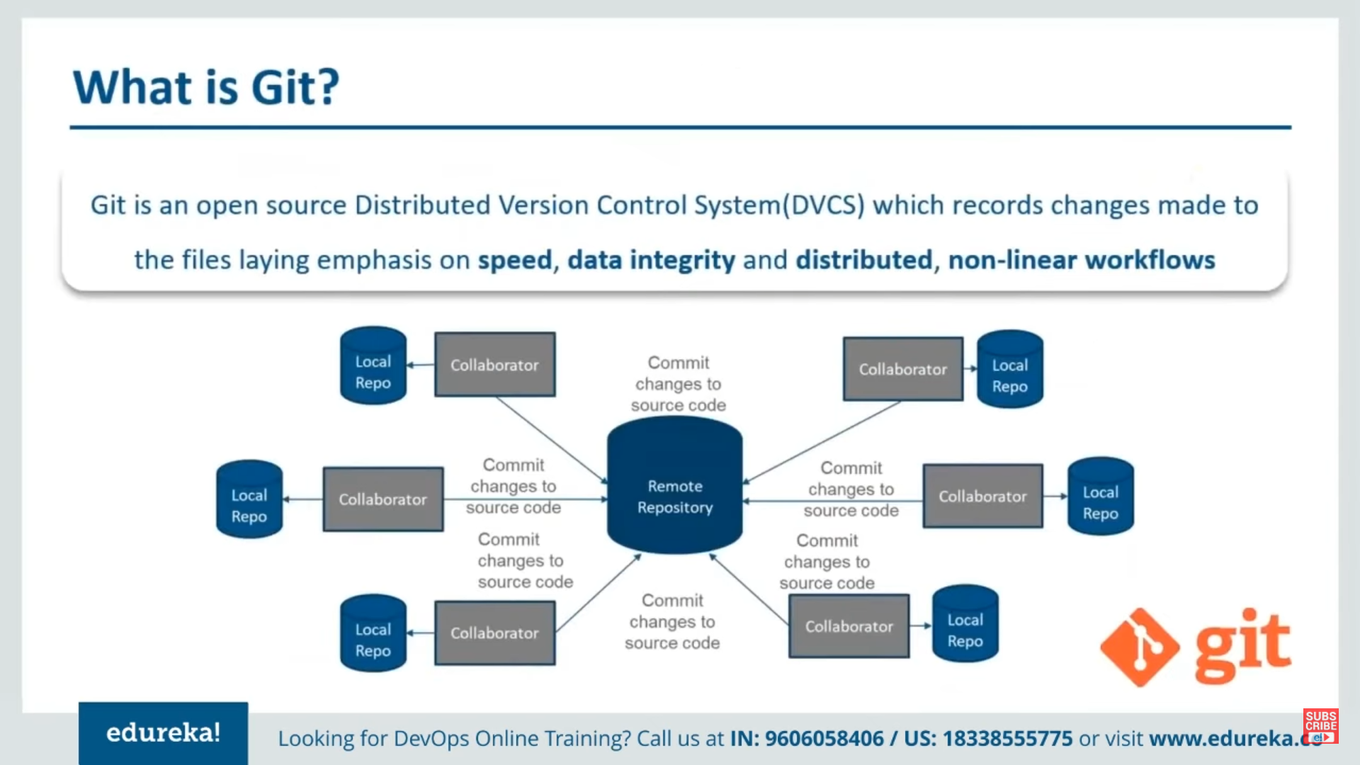

Slide 53
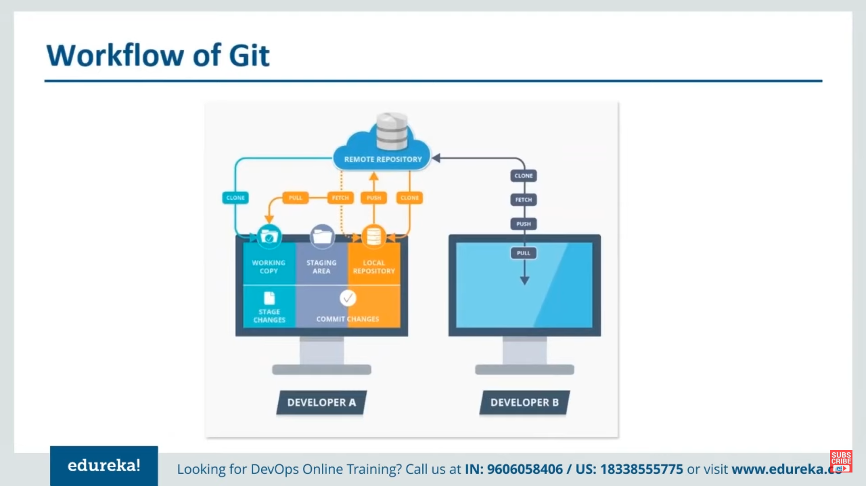

Slide 54
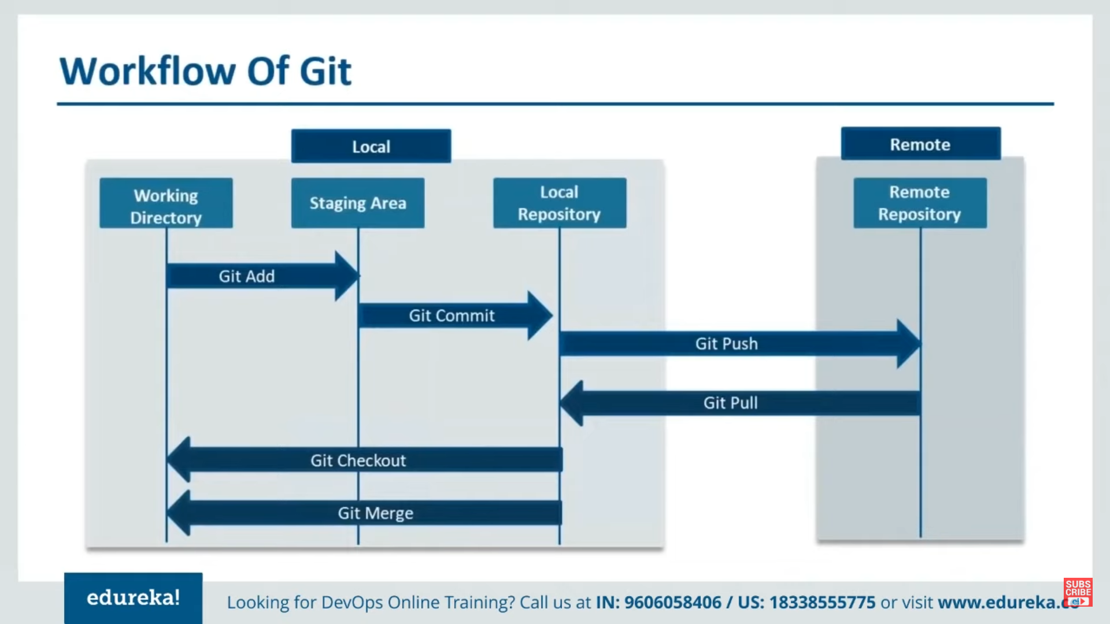

Slide 55
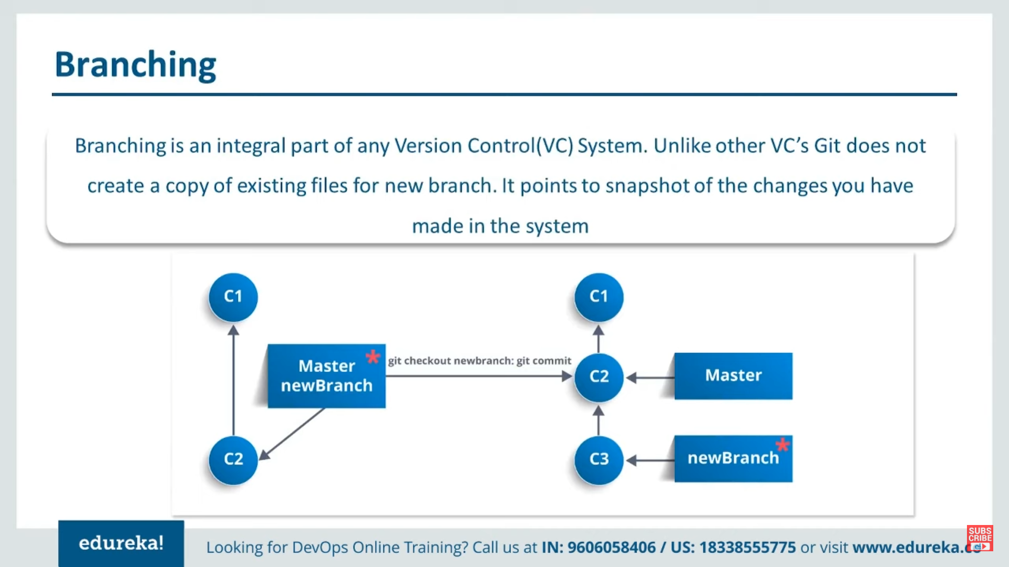

Slide 56
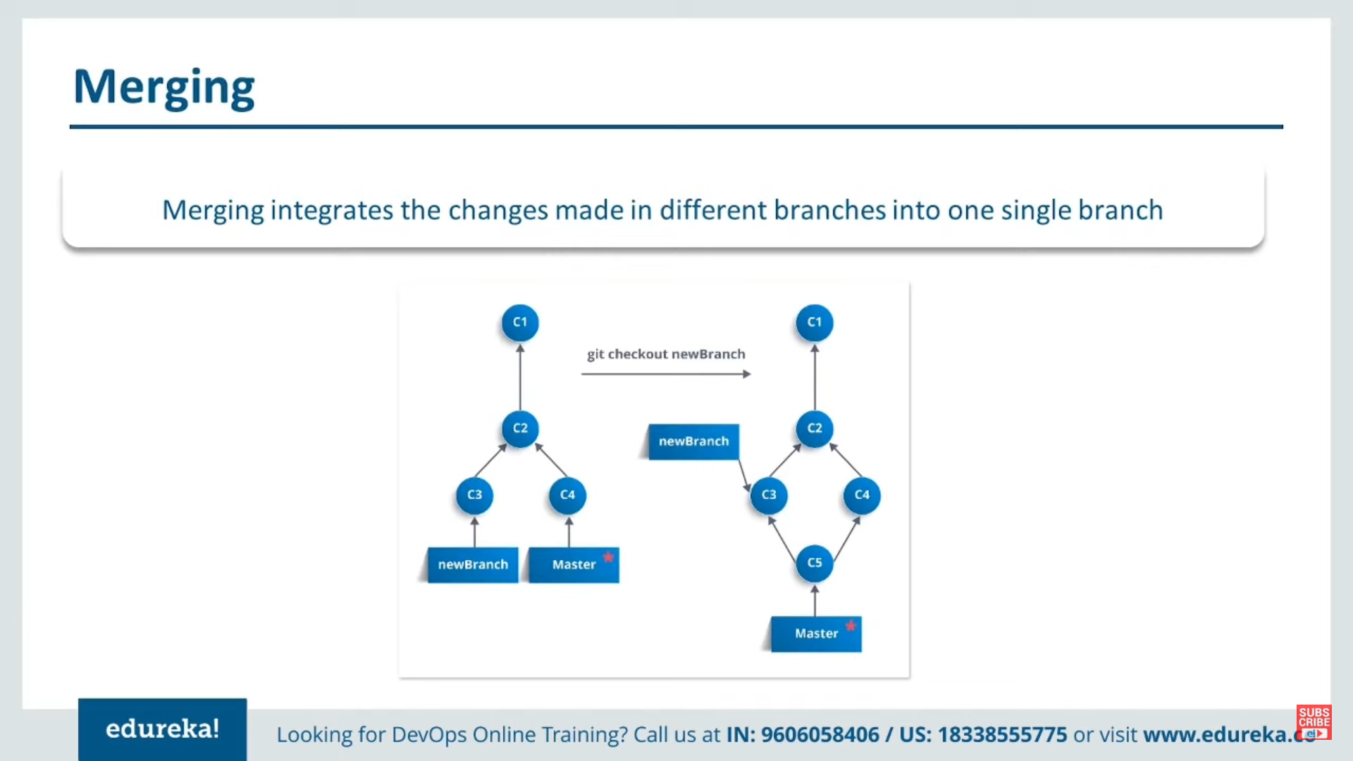

Slide 57
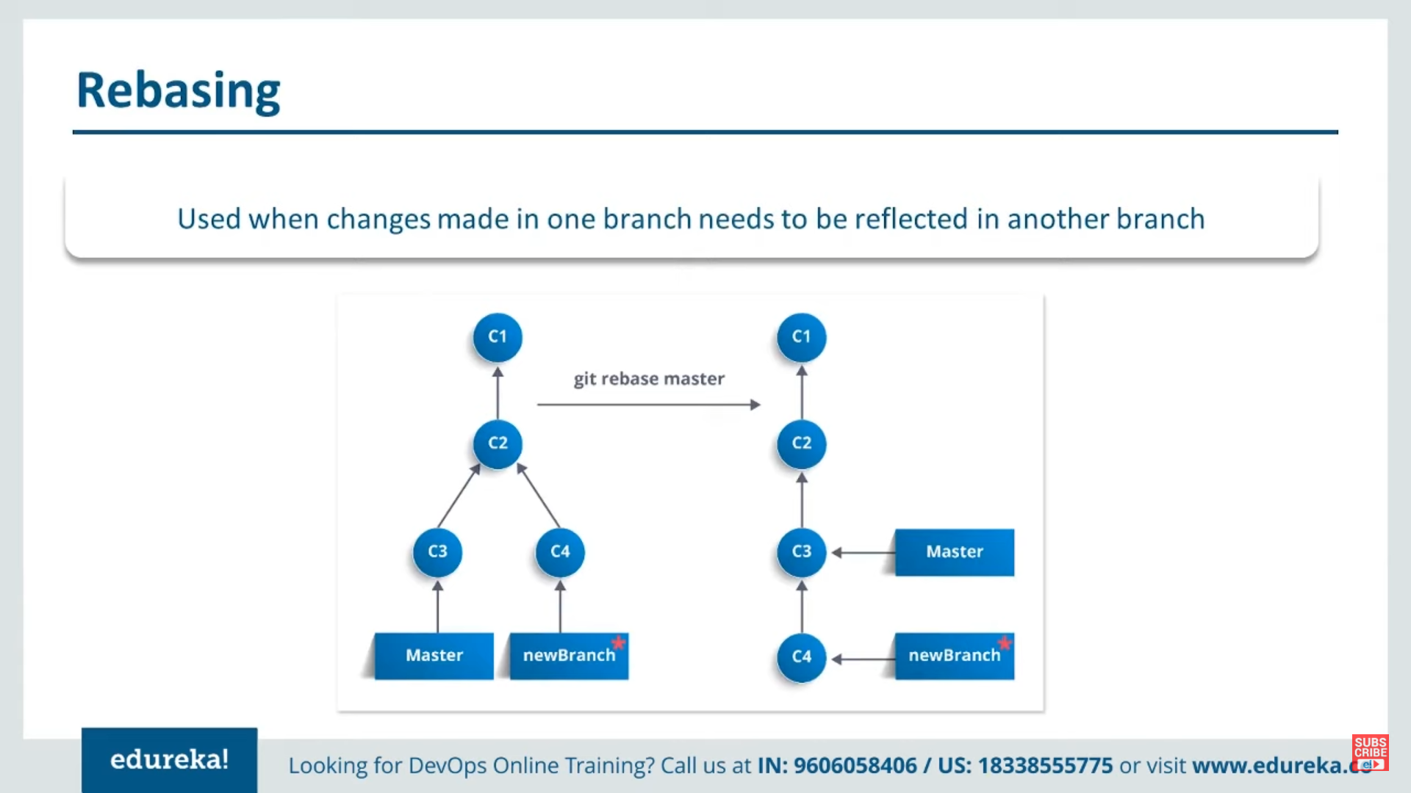

Slide 58
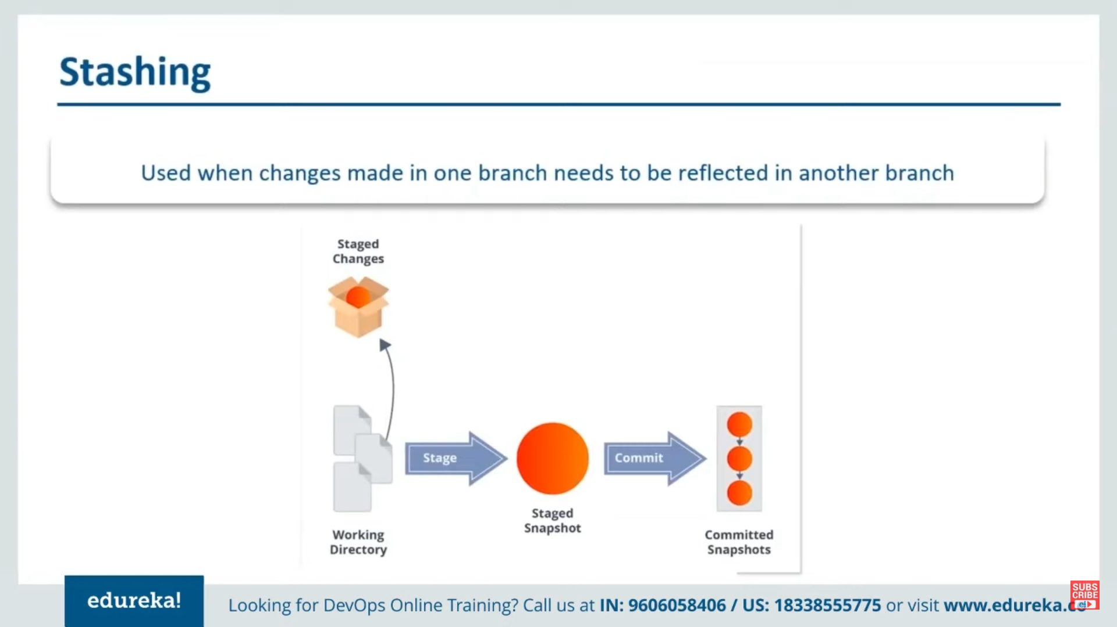

Slide 59
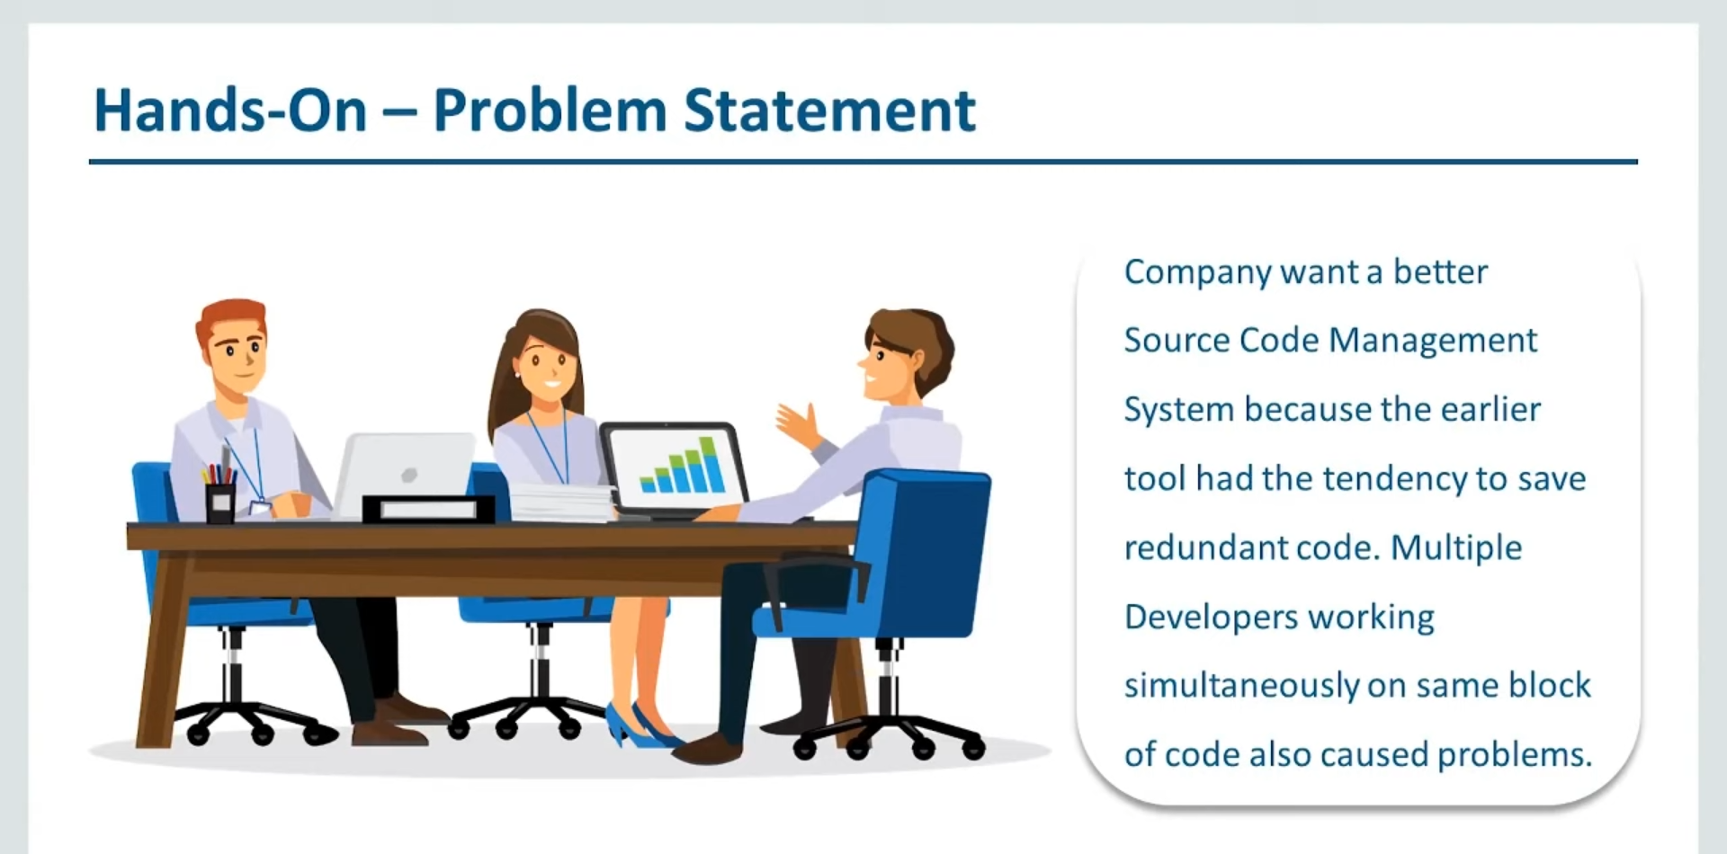

Slide 60
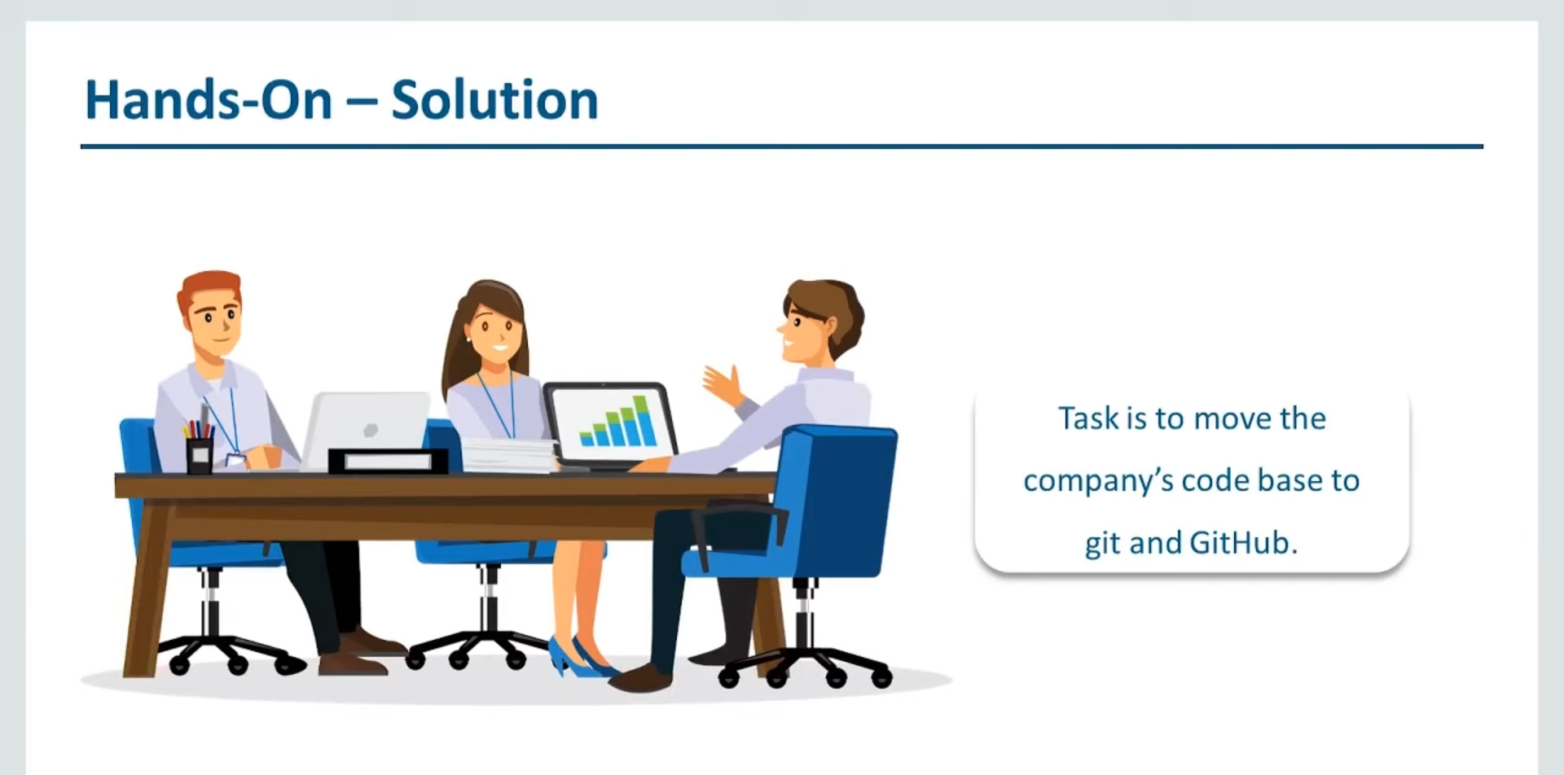

Slide 61
Download and install Git
Here’s the standard one: http://git-scm.com/downloads
Git Repository is a place where Git can store versions of our files
$ cd ~/gitclass
$ mkdir demo
$ cd demo
$ git init
$ dir /ah or $ ls -a (* .git directory to store all the tracing info)

Slide 62
Introduce yourself to Git
Enter these lines (with appropriate changes):
git config user.name "John Smith"
git config user.email jsmith@gmu.edu
--global param

Slide 63
Thank You

